Slide 1
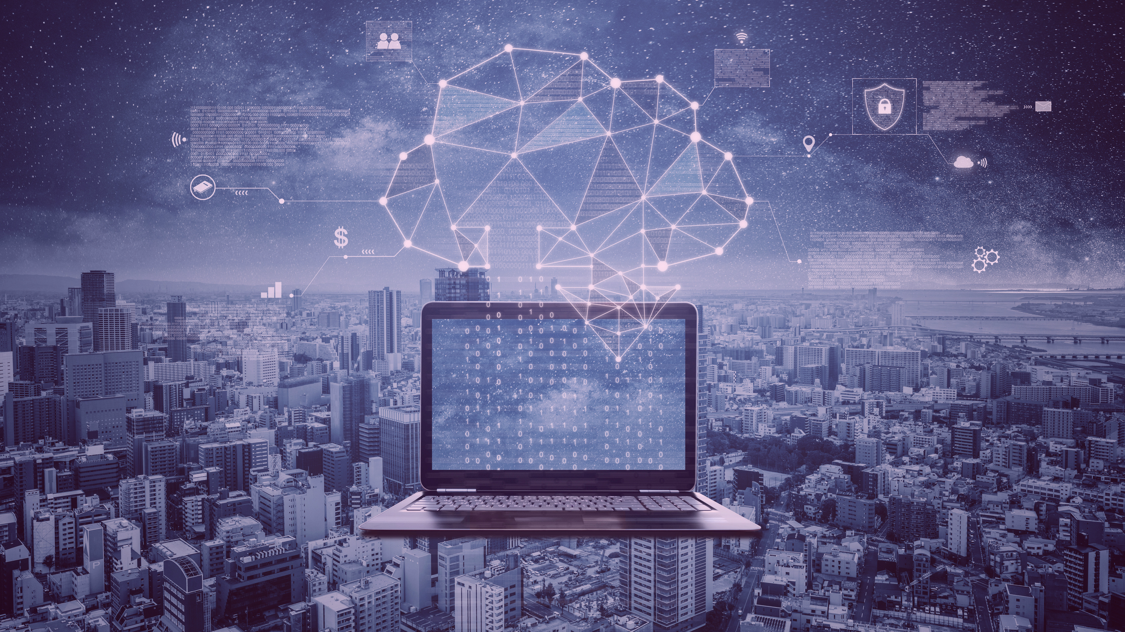
Computer operation and learning about modern technologies
&
Support for mobile devices
LEADER:
PARTNERS:

Slide 2
What is Computer Operations?
Simply put, computer operations means that whatever instructions are given to a computer system, that computer system will execute those instructions.
The process of carrying out given instructions is called computer operation.
2

Slide 3
Basic Operations of Computer System
There are five basic operations of a computer system, which are given below.
Inputting
Processing
Outputting
Storing
Controlling

Slide 4
1. INPUTTING
Inputting is the process by which a user enters any type of data into a computer system.

Slide 6
2. PROCESSING
Processing simply means that the computer system begins to carry out instructions given by the user. This process is called processing.

Slide 7
3. OUTPUTTING
Outputting simply means the output of the results specified by the user.

Slide 9
4. STORING
Storing is the fourth basic operation of computer systems. "Save" simply means to save the output result after executing the user's instruction.

Slide 11
5. CONTROLLING
Controlling is the combination of all computer operations.

Slide 12
Modern Technology: Definition, Examples, Influence and Future

Slide 13
What is Modern Technology?
Modern technology is the evolution of old technology with new additions and modifications.

Slide 14
Examples of Modern Technology

Slide 22
Advantages of Modern Technology
It makes it much convenient to learn and grab information.
Modern technology takes Innovation and Creativity to the next level.
Communications feature improved.
Transportation facilities boosted productivity.
Huge impact in the education industry.
Increased efficiency of people to complete particular tasks.
Entertainment gadgets improved to the extreme.
Numerous equipment got lesser prices with new technologies.
Improved the problem-solving ease.
Helped small businesses to grow faster.
Connected people together through social networking.
The lifestyle became easier.
Improved diagnosis and curing equipment enhanced the health industry.

Slide 23
Disadvantages of Modern Technology
Modern technology creates job insecurity due to the excessive use of robots and machines.
Creation of harmful weapons and machinery.
Increased pollution of air, water, and soil.
It can be a huge waste of time due to addiction to modern gadgets.
It increased competition in every field due to the usage of automation.
It can cause distractions from studies and other natural activities.
Modern technology can affect the creativity of people because of the easiness to do things using technology.
Cybercrimes increased, and almost anything is destructible by brilliant hackers.
Modern technology can create health complications like obesity due to the addiction to devices such as smartphones or tablets.
Affected social life by keeping people attached to tech gadgets.

Slide 24
Influence of Modern Technology in our Society

Slide 26
What is a mobile device?
Mobile device is a generic term for all types of handheld computers. These devices are very portable and often fit in the palm of your hand. Some mobile devices such as tablets, e-readers, and smartphones are powerful enough to do many of the same things that desktop and laptop computers can do.

Slide 36
Thank you for your attention.
More information about the project on the website:
https://kreatywnidlabiznesu.pl/develop-your-creativity/
Funded by the European Union. Views and opinions expressed are however those of the author(s) only and do not necessarily reflect those of the European Union or the European Education and Culture Executive Agency (EACEA). Neither the European Union nor EACEA can be held responsible for them.
LEADER:
PARTNERS:

