Slide 1

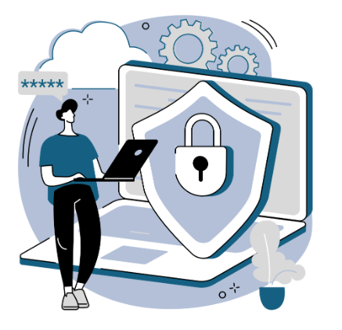





Lesson 1
Phishing
Understanding Cybercriminal Tactics and How to Stay Safe
WZMACNIACZ:
LEWADER:
LEADER:
PARTNERS:

Slide 2

Types of threats
Phishing - Fraudulent phishing attempts by cybercriminals

Slide 3

Types of threats
Social engineering
manipulation
instilling fear
the need for quick action

Slide 4
Phishing recognition
Division of the class into 3-4 groups.
Each group receives a set of emails (real and fake) and pages/campaigns.
Task for groups: Assess which messages may be phishing attempts.
Time for analysis: 5 minutes
Presentation of results: Each group presents its conclusions (2 minutes per group).

Slide 5
Sheet 1

Slide 6
Phishing Recognition Criteria
Task for groups:
Re-evaluate messages can be phishing attempts, based on the following criteria:
Criterion 01
Match the sender's email address
Criterion 02
Linguistic correctness and the use of polite forms
Criterion 03
Assessing whether the student is a natural recipient of the message
Criterion 04
Does the message urge to: open a link, attachment, provide confidential information?

Slide 7
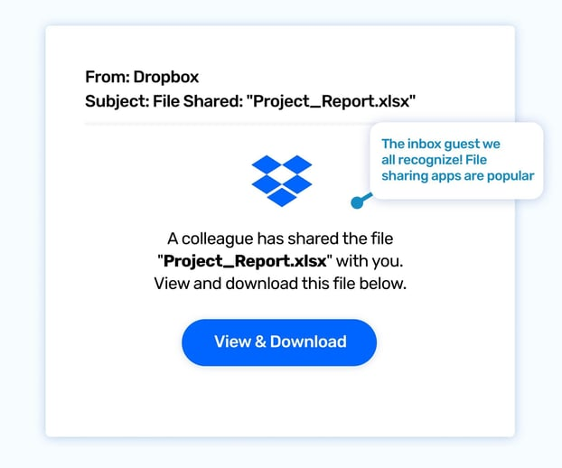
Be Vigilant – What to Look for
Bait, natural curiosity
It's Friday night and you're scrolling through your emails. One message from Dropbox catches your eye: "Shared file: 'ProjectX_Financial_Report_Q2.xlsx'". You are working on a project, the report was supposed to be later. You click on the link to check the file... and you get more than you expected.
https://www.wizer-training.com/blog/email-phishing-template-june-2024

Slide 8
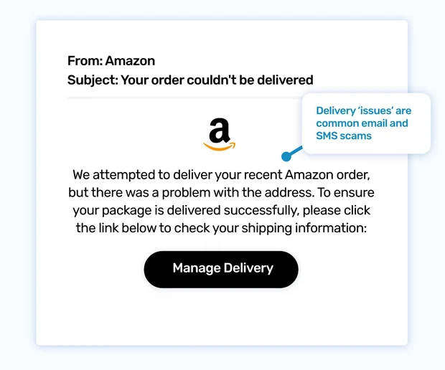
Be Vigilant – What to Look for
Delivery slip
You are waiting for a package from Amazon. Suddenly, you get an email that they couldn't deliver it due to an issue with the address. You panic and quickly click on the link to update the data, not realizing it's a phishing scam.
https://www.wizer-training.com/blog/email-phishing-template-june-2024

Slide 9
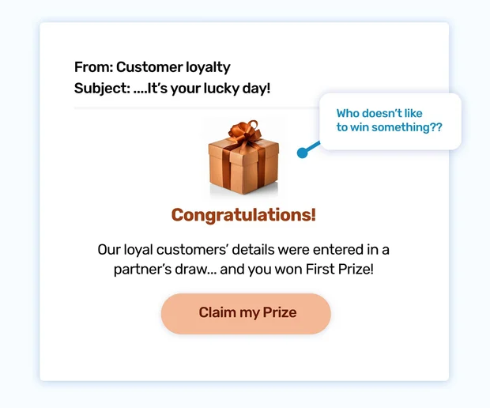
Be Vigilant – What to Look for
Congratulations, you've won!
You're browsing through your inbox when you suddenly see a colorful email. The email looks real thanks to a familiar brand. "From this company? I don't remember taking part in the competition..."
Out of curiosity, you open the message. Congratulations — you've won a great prize! Excitement is growing. Without hesitation, you click on the link to claim your prize...
https://www.wizer-training.com/blog/email-phishing-template-july-2024

Slide 10
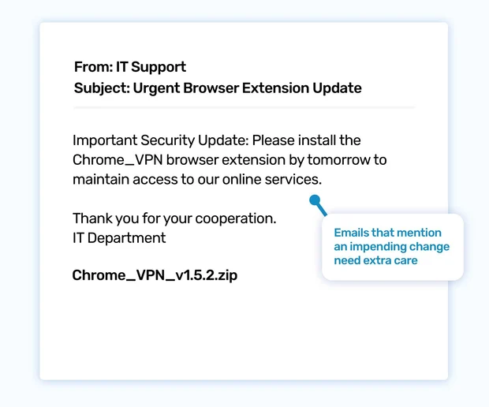
Be Vigilant – What to Look for
Attempts to force quick action ("you have to do it now!")
You are in a hurry to finish a project and use cloud tools. Suddenly, you get an urgent email from your IT department: "You need to update your browser extension immediately!" The message warns you that you will lose access to important platforms if you don't. In a panic, you click the link to install the update because you are afraid that your work will be interrupted.
https://www.wizer-training.com/blog/email-phishing-template-july-2024

Slide 11
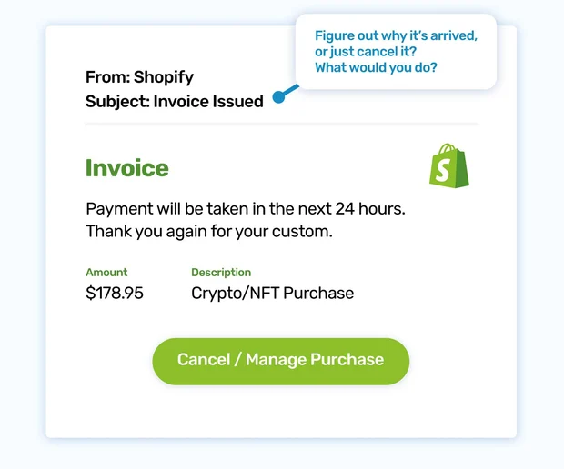
Be Vigilant – What to Look for
Strange or unfamiliar situations, fear of charges
You open your inbox and see an email from Shopify with the subject line "Receipt for your last purchase." You're starting to worry — did you buy something? Maybe you forgot about your old subscription? You look through the email and see the "Cancel order" button. You calm down, thinking that you can stop the payment. You click without thinking...
https://www.wizer-training.com/blog/email-phishing-template-july-2024

Slide 12
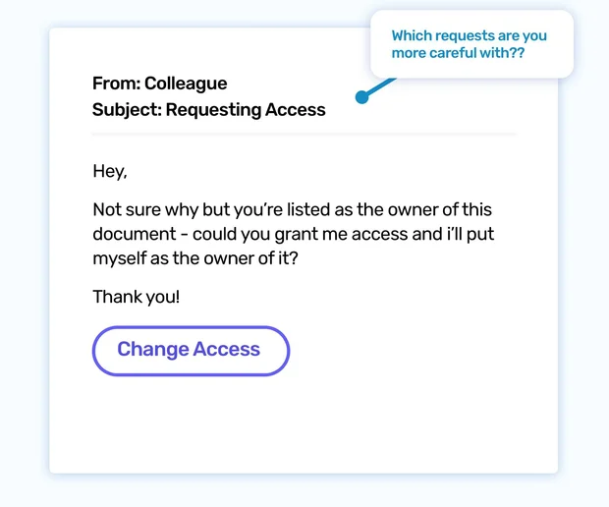
Be Vigilant – What to Look for
An unusual sender name that doesn't match...
You get an email from a colleague asking: "I can't open the document you created, grant me access rights."
It looks innocent, so you click the link to help. But suddenly something worries you — this email may not be legitimate.
https://www.wizer-training.com/blog/email-phishing-template-june-2024

Slide 13
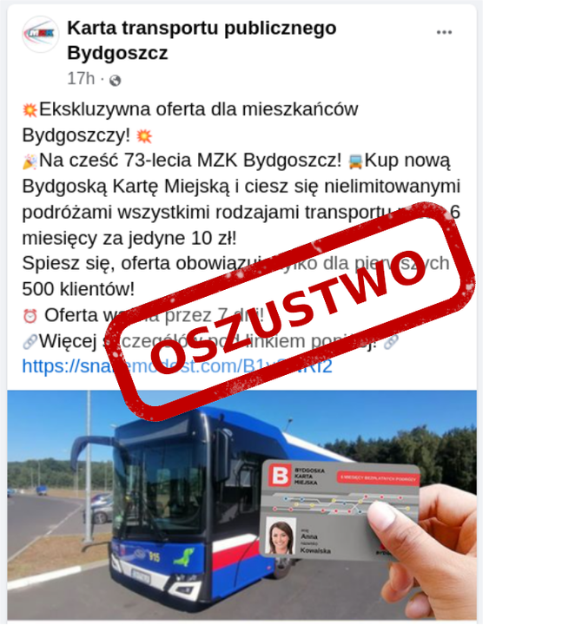
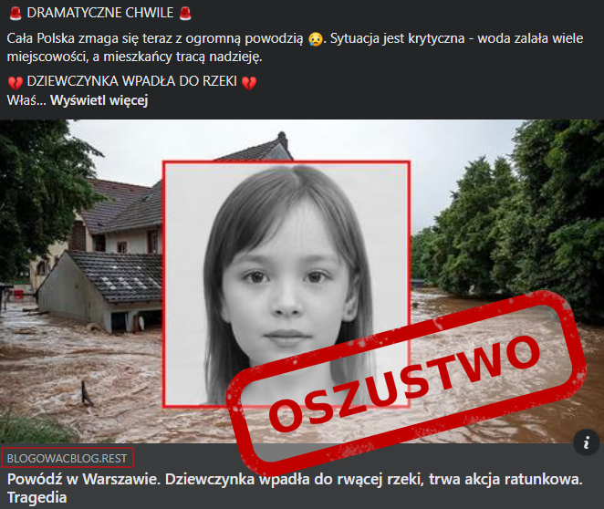
Be Vigilant – What to Look for
A link that does not come from the company's official domain
https://x.com/CERT_Polska/status/1835672577529819309/photo/1
https://x.com/CERT_Polska/status/1828464423817589131/photo/1

Slide 14
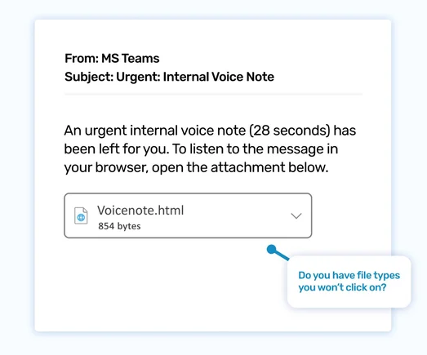
Be Vigilant – What to Look for
Attachments in non-standard formats (e.g., .exe, .zip)
Today you have classes remotely. You are preparing your lunch and see that you get a message to MS Teams: "You have been left an urgent voice note (31 seconds)". The heart starts beating faster. Urgent? Maybe it's a teacher or a principal? Fear is growing.
You're about to open an attachment, but suddenly you're thinking, "Wait, do we even use voice memos in Teams?"
https://www.wizer-training.com/blog/email-phishing-template-june-2024

Slide 15
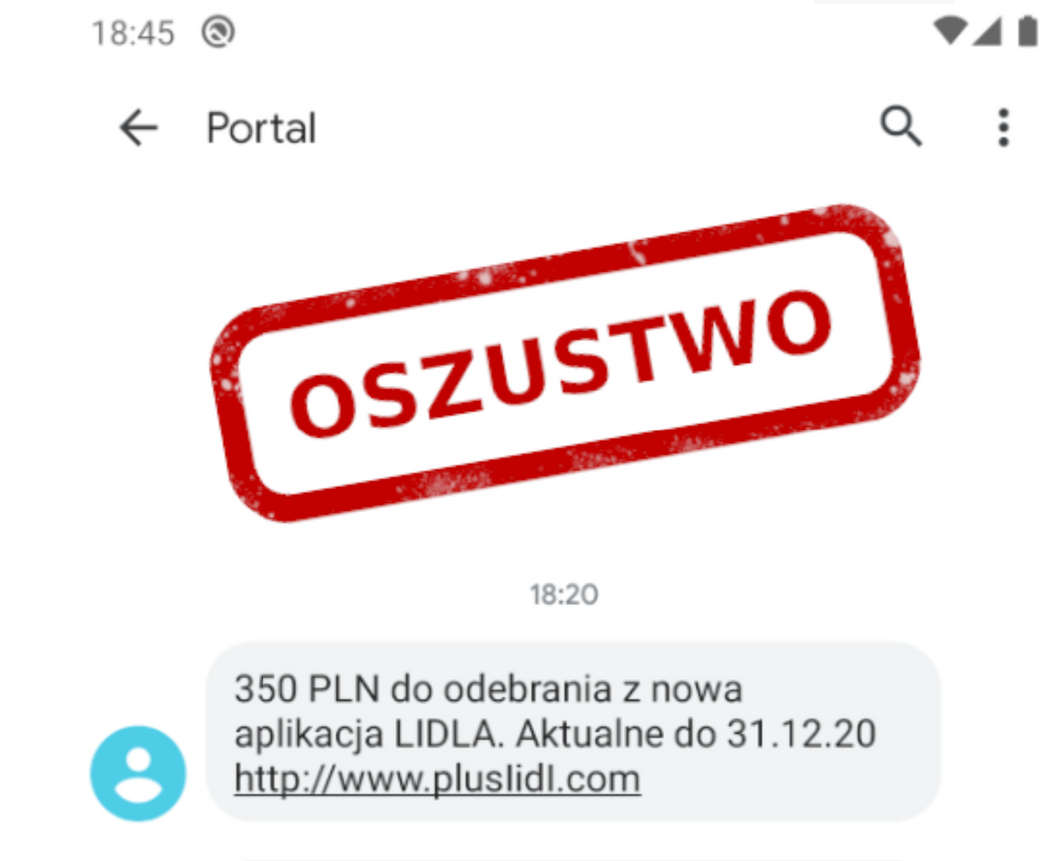
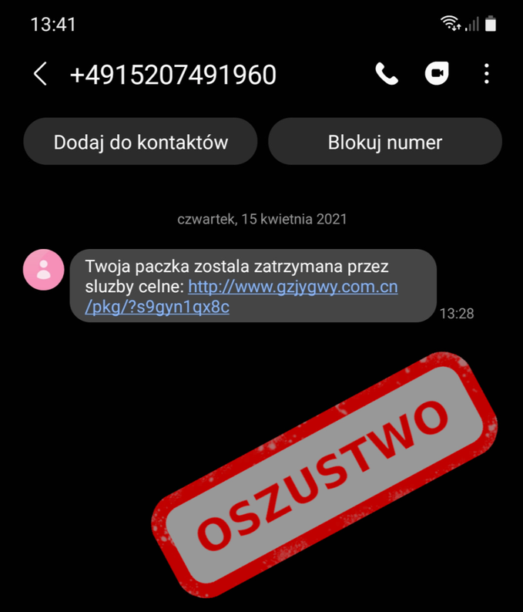
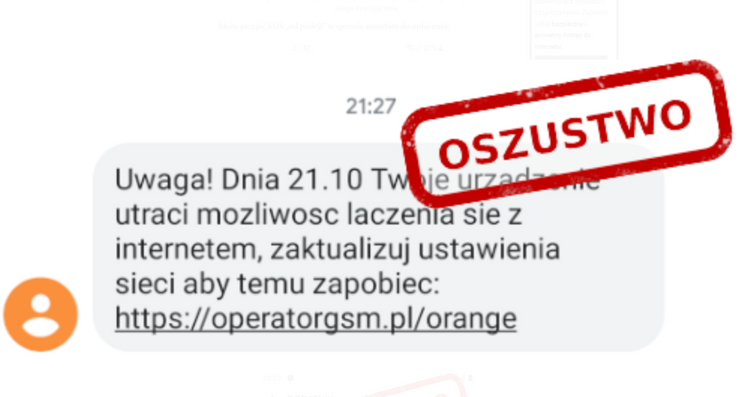
SMS phishing Smishing
Beware of text messages with fake links!
https://kwestiabezpieczenstwa.pl/phishing/#:~:text=Spis%20tre%C5%9Bci.%20Co%20to%20jest%20phishing?%20Phishing%20%E2%80%94%20przyk%C5%82ady

Slide 16

1.
Don't trust information you can't check
How to defend yourself against social engineering?
2.
Do not click on links from suspicious messages
3.
Don't share your passwords or bank details
4.
Don't act on your emotions – take a deep breath/close your eyes for a moment, think twice

Slide 17
How to defend yourself against phishing?
1
Don't click on links in unwanted messages
2
Be careful with attachments in messages - they can be dangerous
3
Never give out sensitive data such as passwords or card numbers
4
Always check the URLs of the websites you visit
5
Update your browser regularly to keep it safe

Slide 18
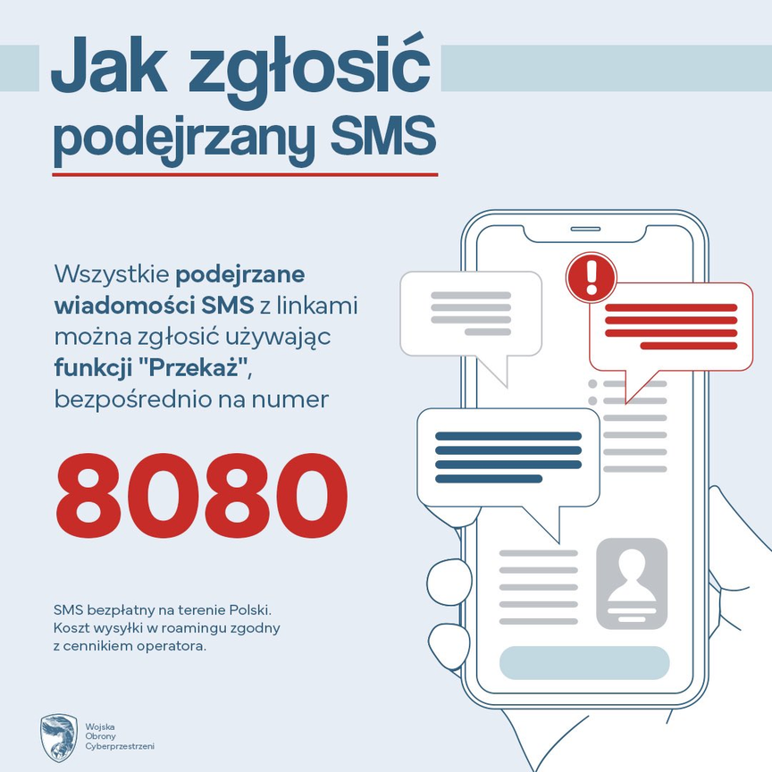
Remember this number
  Report suspicious messages
  Send an SMS with links to 8080
https://incydent.cert.pl/#!/lang=pl

Slide 19
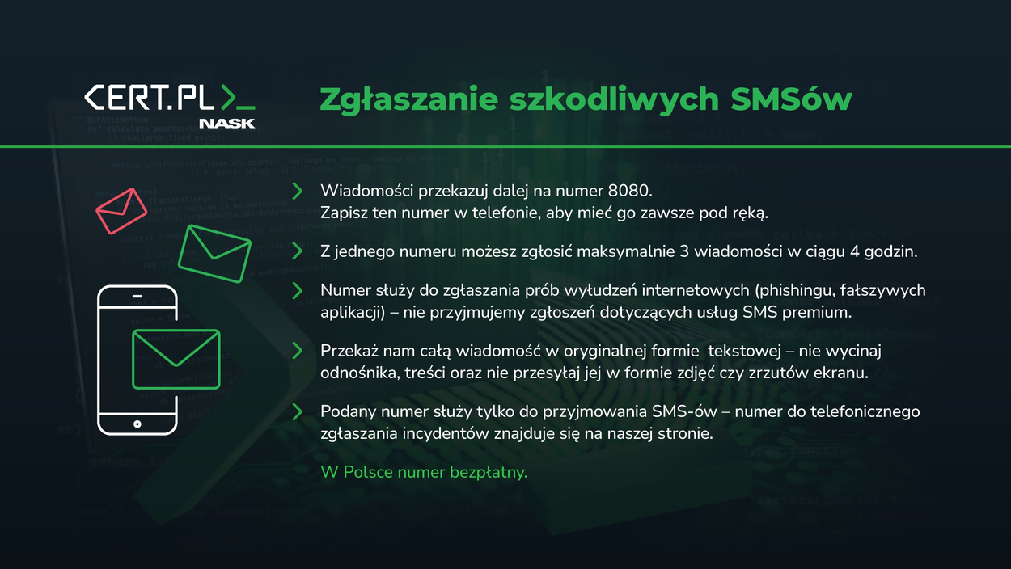
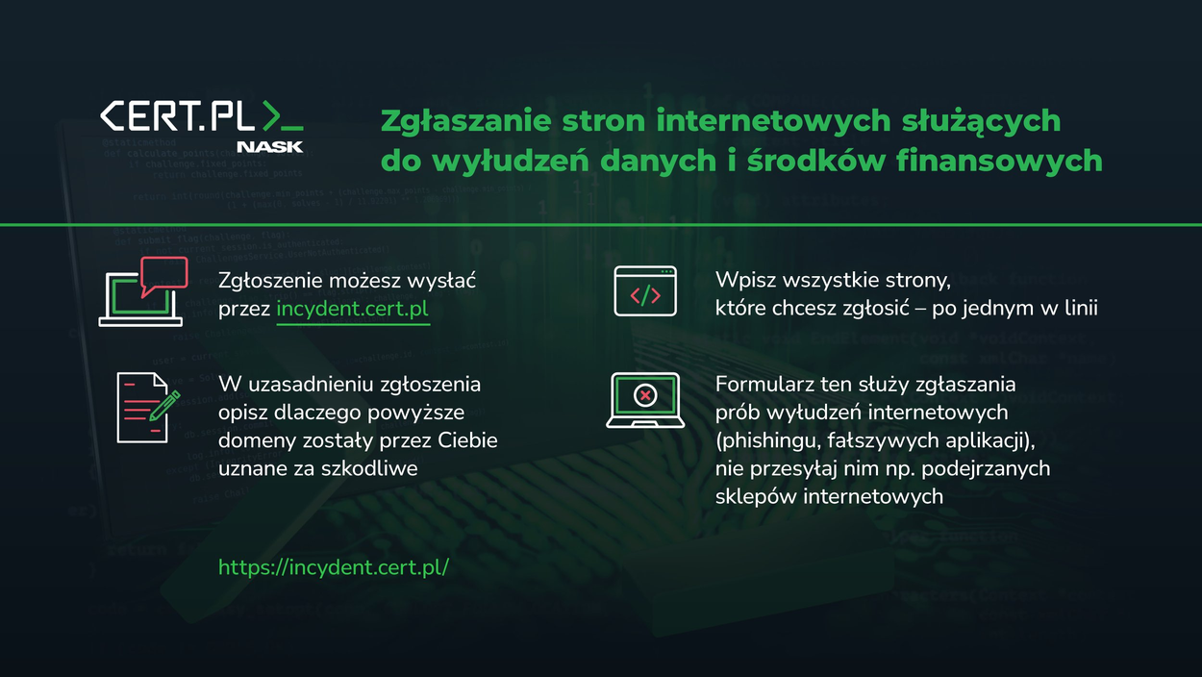
Report !

Slide 20
1.
Most online services have security (and phishing investigation) teams
How to Stop Phishing Emails
2.
If you get a suspicious email, report it as phishing
3.
Google the name of the company and add the word "phishing" (e.g., "Report Steam Phishing")
4.
You will find instructions on where to send such an email to help the company stop hackers
5.
When you notice a suspicious website address, report it to Google Safe Browsing (https://safebrowsing.google.com/safebrowsing/report_phish/?hl=en )

Slide 21
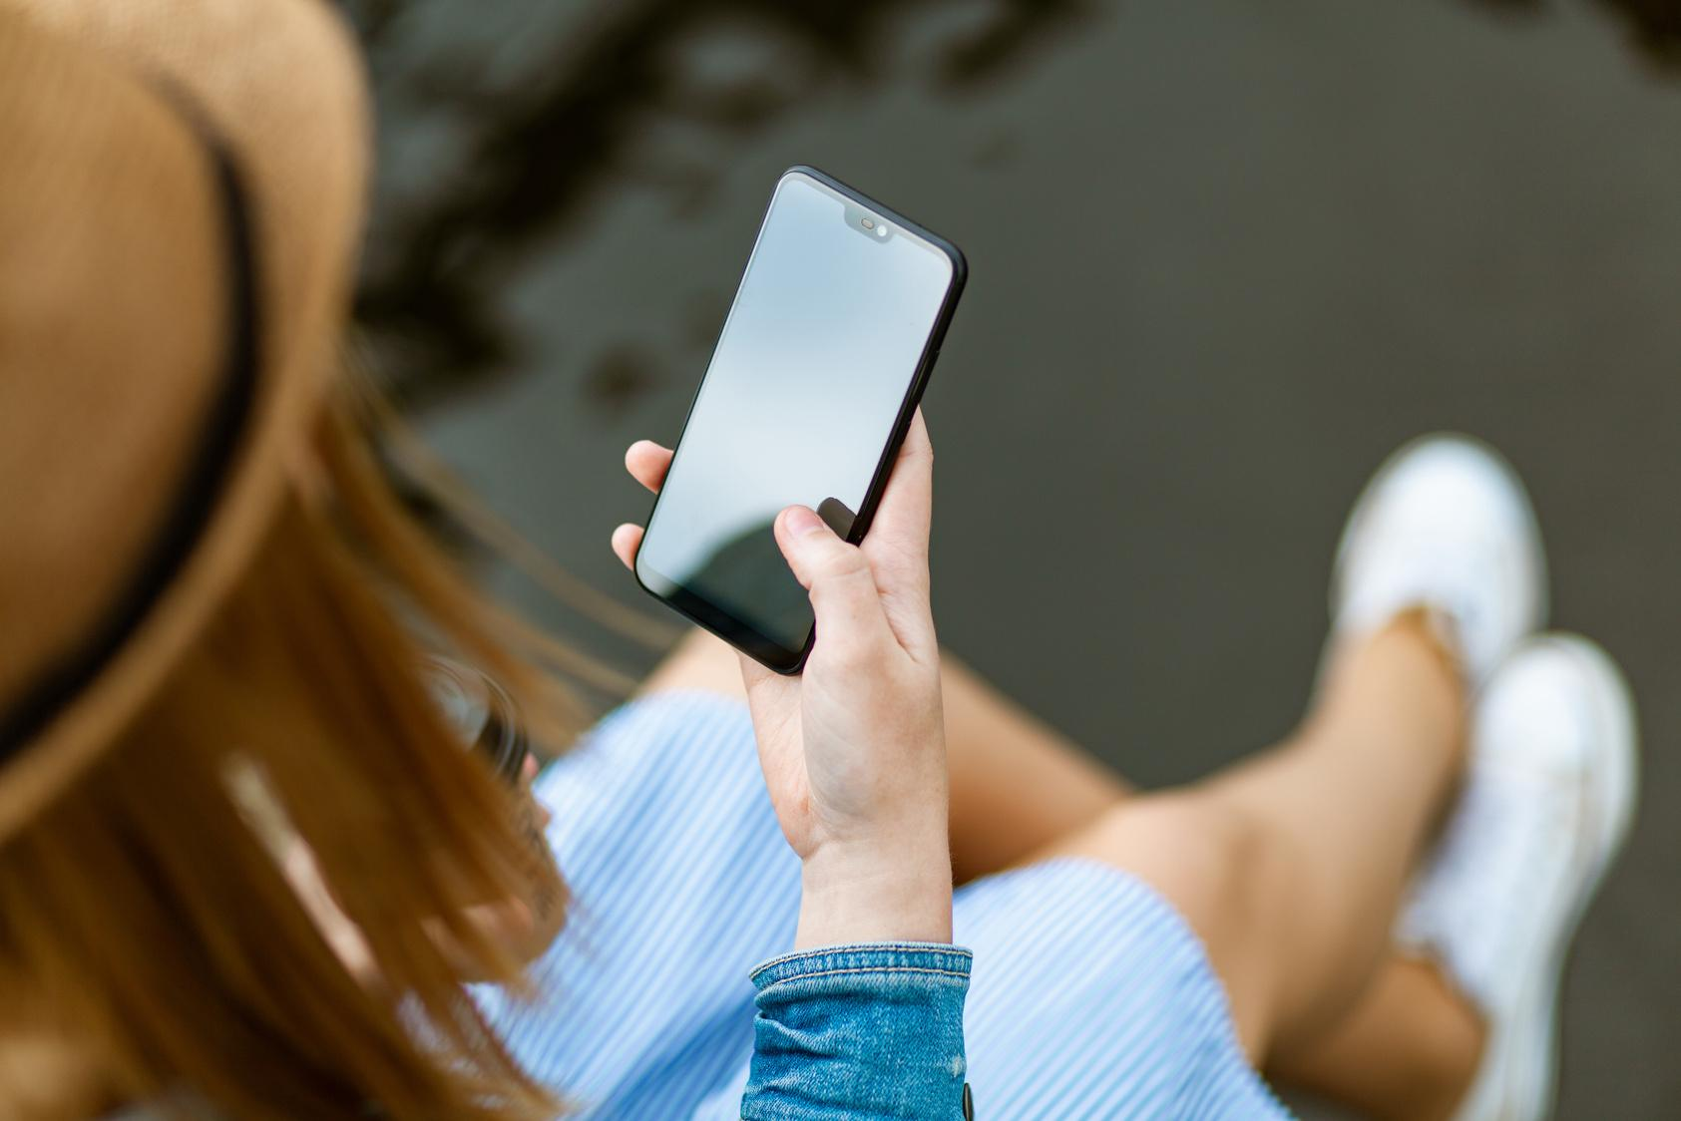
A phone is also a computer
  Permissions vs. surveillance: Apps often ask for access to your data, but be careful what you share with them — they can track your activity
  Security and good practices: Always keep your software up to date, use a screen lock, and don't install suspicious apps
  Safety of children and teenagers: Do not click on suspicious links, do not give your data to strangers, even in games

Slide 22
Homework
Check what permissions your apps have and think about whether you really need all of them?

Slide 23

Further information
about the project
https://www.coventry.ac.uk/wroclaw/
https://kreatywnidlabiznesu.pl/cyber-sec-edu-check/
https://eccedu.net/
Funded by the European Union. However, the views and opinions expressed are those of the author(s) only and do not necessarily reflect the views of the European Union or the European Education and Culture Executive Agency (EACEA). Neither the European Union nor the EACEA can be held responsible for them.
All results developed within the framework of this project are available under open licenses (CC BY-NC 4.0). They can be used free of charge and without restrictions. Copying or processing these materials in whole or in part without the author's consent is prohibited. In the case of using results, it is necessary to provide the source of funding and their authors.
PROJEKT NR 2023-2-PL01-KA210-VET-000176822
LEADER:
PARTNERS:

