Slide 1

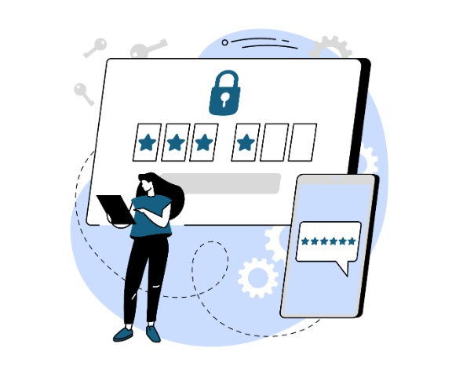





Lesson 2
Password
Creating and Managing
Secure Access
WZMACNIACZ:
LEWADER:
LEADER:
PARTNERS:

Slide 2
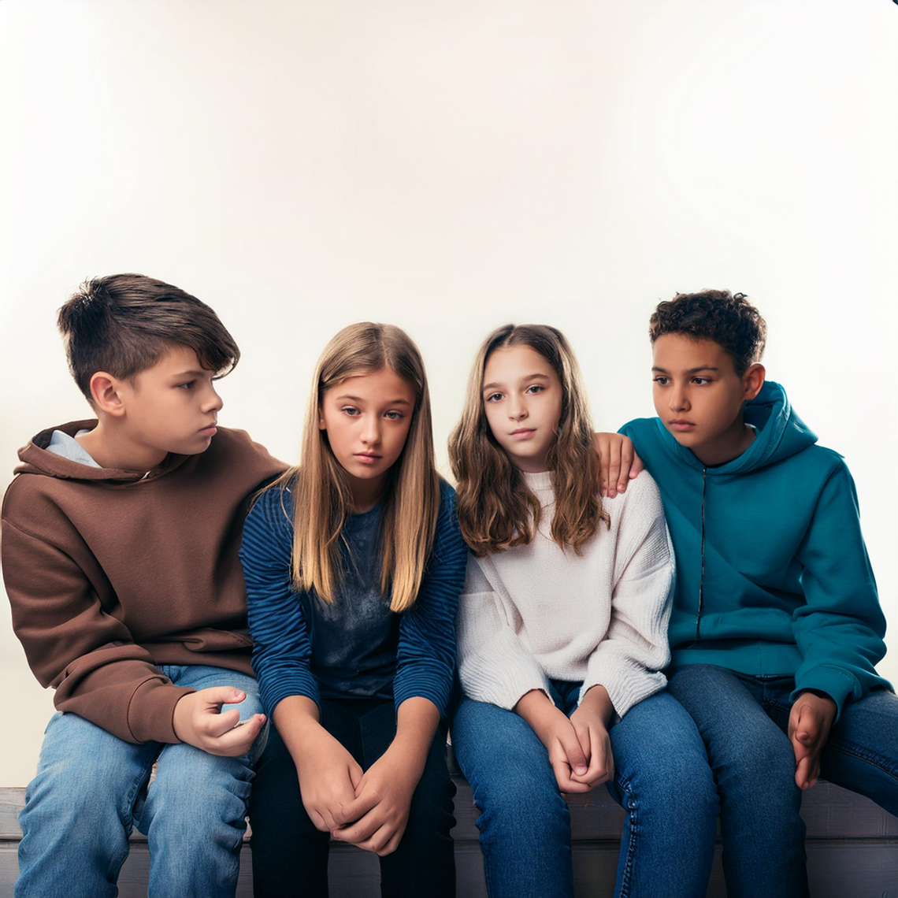




First, a few stories
I shared the password with a colleague because he needed access to my game account. After a few days, I discovered that he had changed my password and was using my account to gain an advantage. I lost all the achievements I had been working on for months.
By accident, I left my laptop open at school. Someone got into my account on a social media platform and posted offensive content pretending to be me. Now I have serious problems and I have to explain myself to my teachers and friends
I clicked on a suspicious link that looked like it was from a friend. Instead of checking what the site was, I entered my login credentials. I was immediately logged out of all devices and my account was compromised. Now I'm without access to important data and I don't know what to do.
I ignored the warnings about strong passwords and set a very simple password for my bank account. Someone broke it and wiped my account to zero. Now I have to fight for a refund and I'm very afraid that I won't get everything back.
Notes:
Czy te historie są prawdziwe?
Nie. Co nie znaczy, że nie mogły się wydarzyć

Slide 3
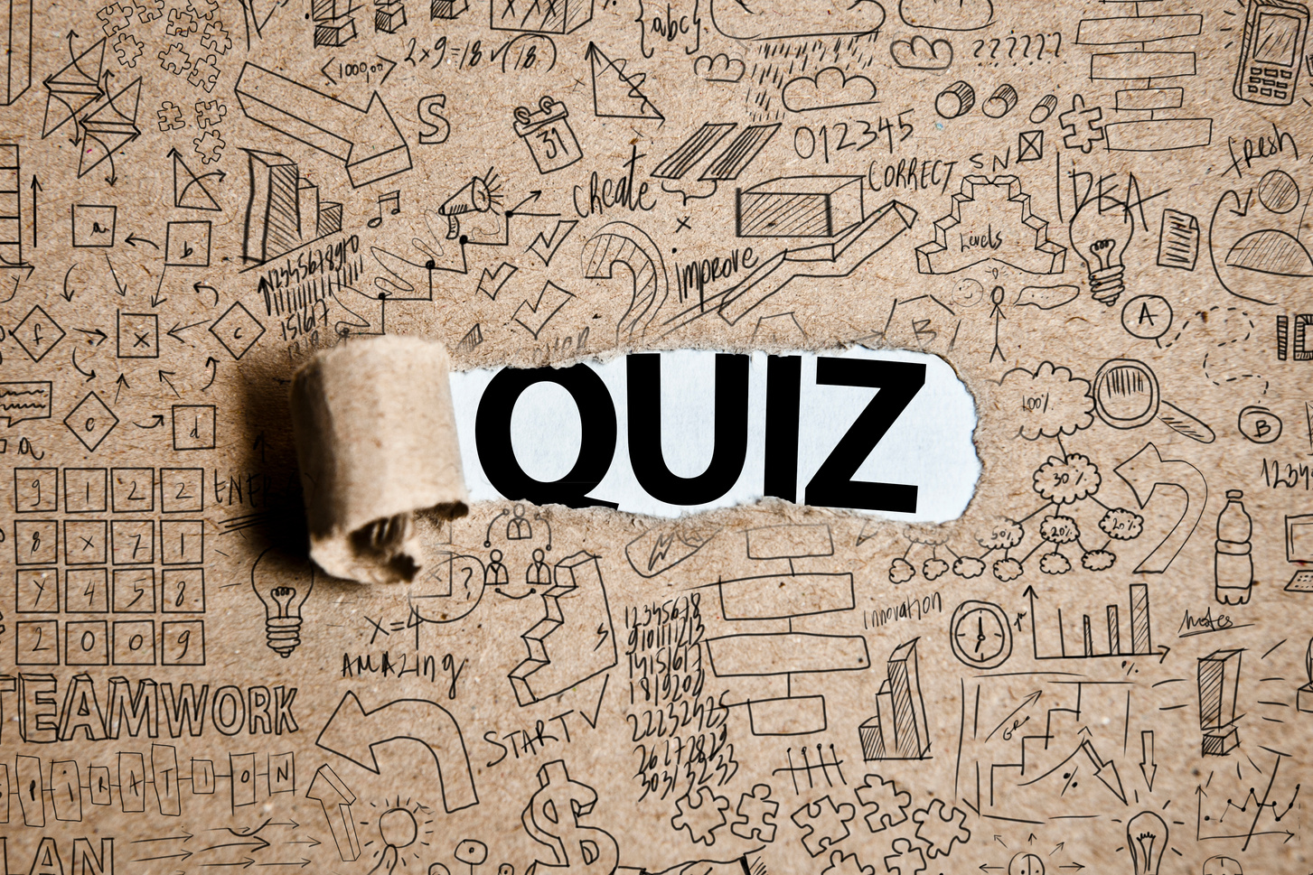
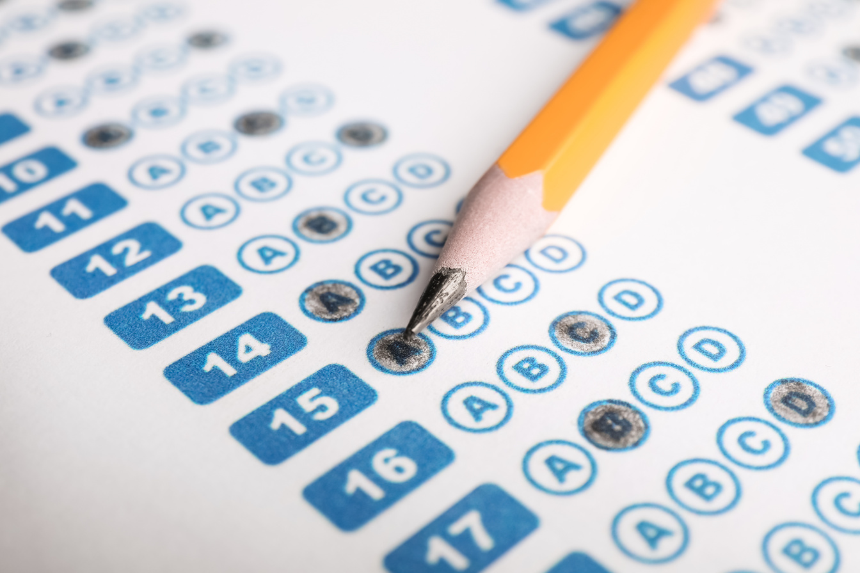
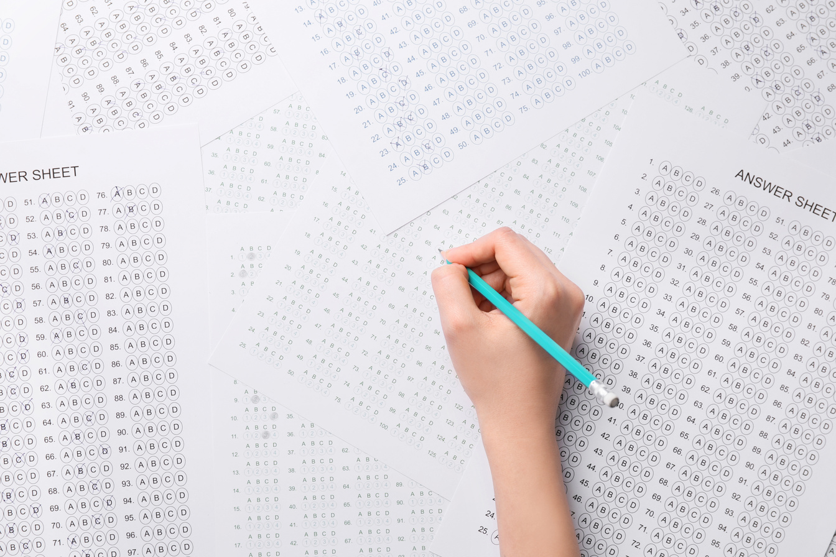
Mini Quiz
The quiz consists of five questions,
One answer is correct.
Write down your answers.

Slide 4

a
JPL93#q
1. Which password is the most secure?
b
anna1234!
c
Bazylia456
d
Idzspachackerzeniezlamiesztego

Slide 5
a
MojeHasło123
2. Which password is the easiest to guess?
b
Letni2024
c
Super!2023
d
Qwerty!123

Slide 6
a
Qwerty123
3. Which password is the least secure?
b
P@ssw0rd
c
1234abc!
d
Secure*Pass123

Slide 7
a
K!ngC0bra
4. Which of the following passwords might be the easiest to guess if the hacker knows your pet's name and date of birth?
b
L0veCats!
c
Adventure987
d
Fluffy2021

Slide 8
a
Feature on phones that speeds up battery charging
5. What is 2FA?
b
An abbreviation for two antivirus filters running simultaneously
c
It's an extra security feature that helps make sure only you can log in, even if someone knows your password
d
Cloud encryption system that enhances file security

Slide 9


Response
1d ) The longer the password, the harder it is to crack. Ideally, the password should be 15 characters or more. A password can be 4 or more non-obvious words glued together
2 a) MyPassword123 is the easiest to guess because it uses simple words and number sequences that are often used in passwords by many people. Other passwords are also predictable.
3 a) The weakest password is Qwerty123. This is a popular password based on a simple keyboard pattern and easy to guess in dictionary attacks. Other passwords contain different character types and are less predictable, although they may still require additional improvements.
4 d) The easiest password to guess is Fluffy2021 because it contains the name of the animal and the date, which makes it easier for a hacker to guess the password with the knowledge of this information.
5c) 2FA (Two-factor authentication) is a way to add extra security to your account, in addition to just your password. It works in such a way that after entering the password, you still have to confirm your identity in another way, e.g. by entering a code from a text message, using a special application (such as Google Authenticator) or having a special key. This makes your account much more secure

Slide 10
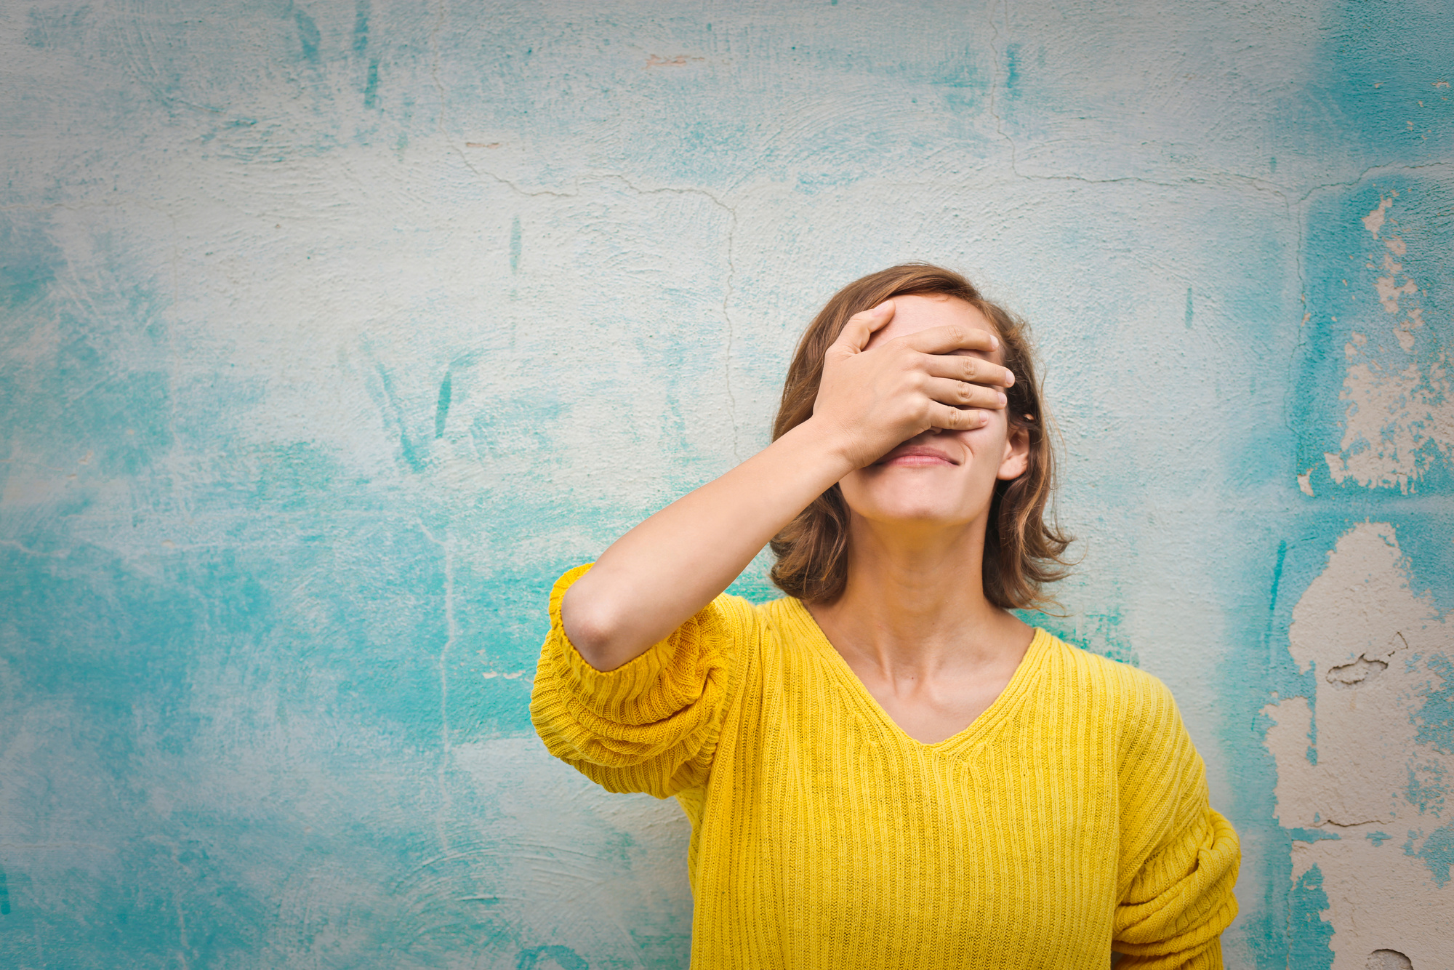

What mistakes do we make?
How many different passwords do you use for your accounts?
How often do you use the same password for several different accounts?
How often do you change your passwords?
How often do you forget your password?

Slide 11
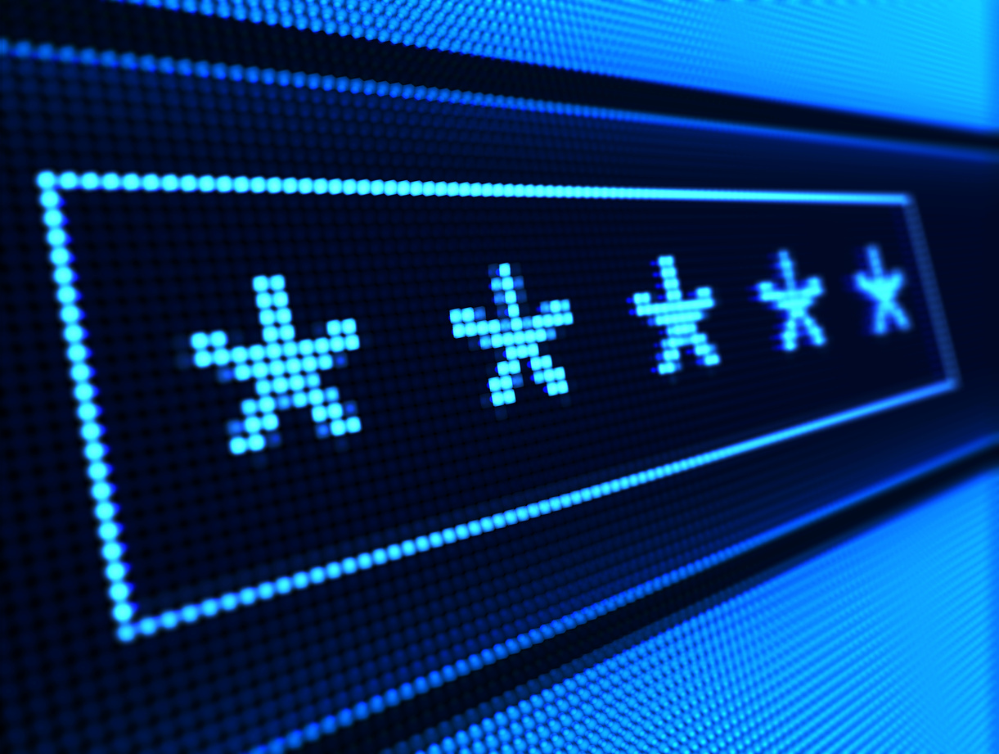
What mistakes do we make?
We often use the same password on several websites
TikTok
goosiaczek2245@gmail.com
MegaTrudneHaslo123!
Poczta
goosiaczek2245@gmail.com
MegaTrudneHaslo123!
Szkoła
1989817
MegaTrudneHaslo123!

Slide 12
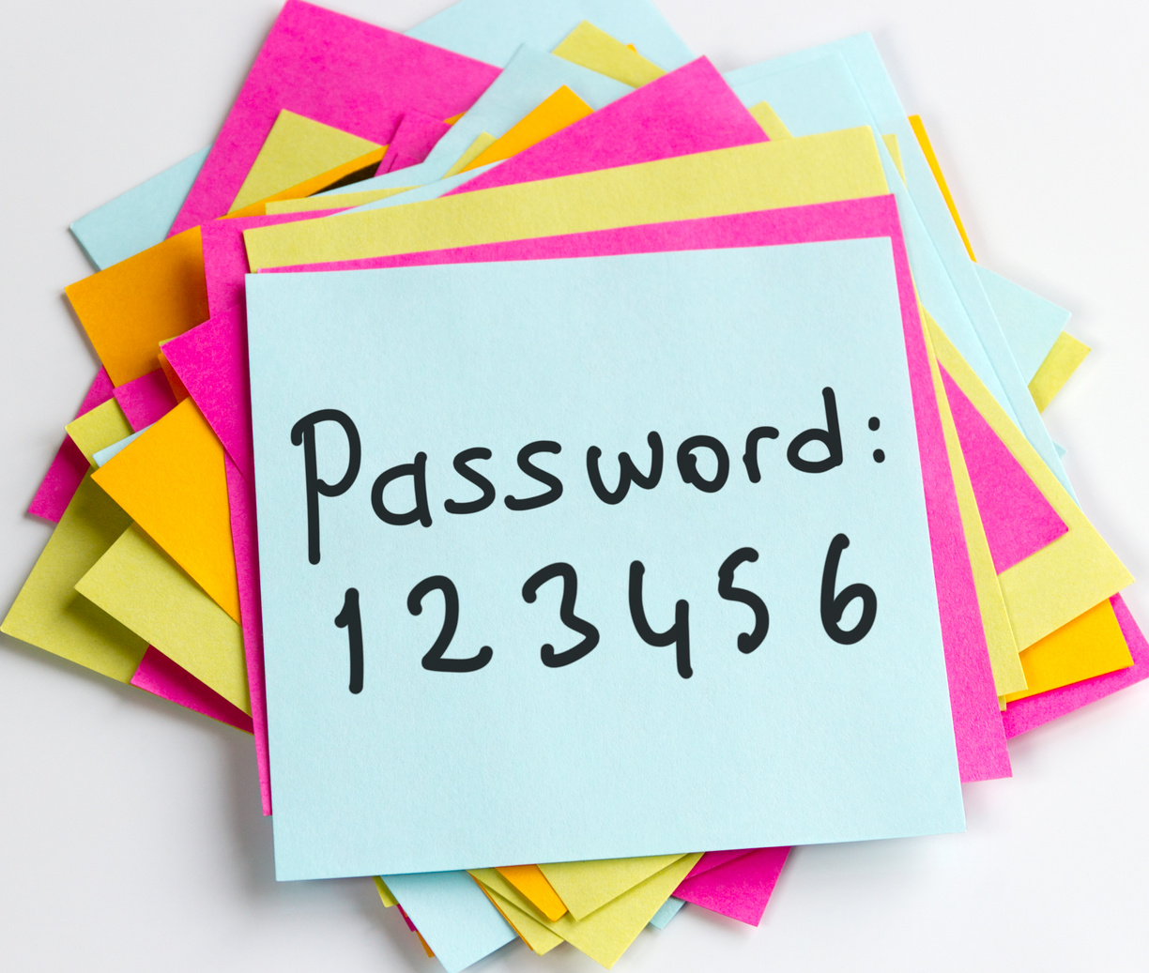
What mistakes do we make?
We often use similar passwords
TikTok
goosiaczek2245@gmail.com
MegaTrudneHaslo1!
Poczta
goosiaczek2245@gmail.com
MegaTrudneHaslo2!
Szkoła
1989817
MegaTrudneHaslo3!

Slide 13
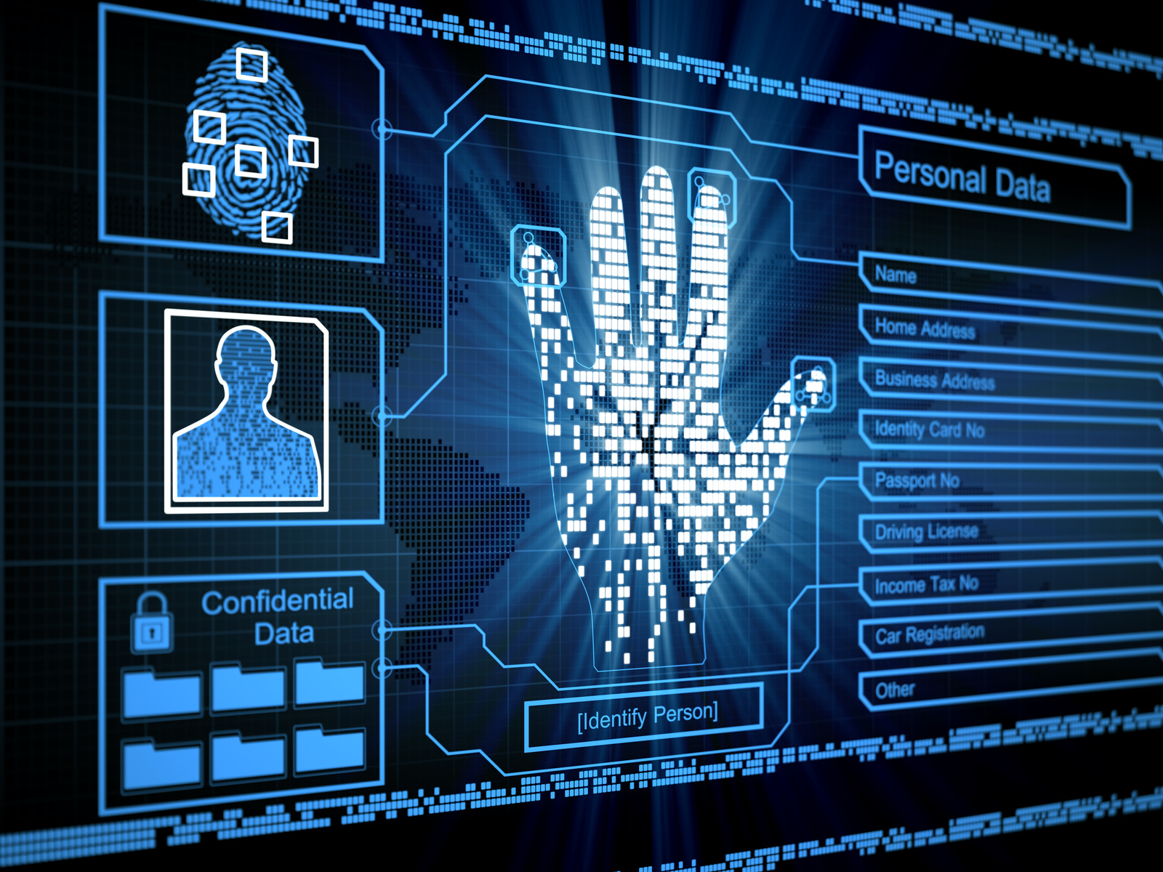
What mistakes do we make?
We use personal information
TikTok
goosiaczek2245@gmail.com
Spooky!Dog
Poczta
goosiaczek2245@gmail.com
SpookyMoj@Piesio
Szkoła
1989817
XXXXXXXXXXX (numer PESEL)

Slide 14
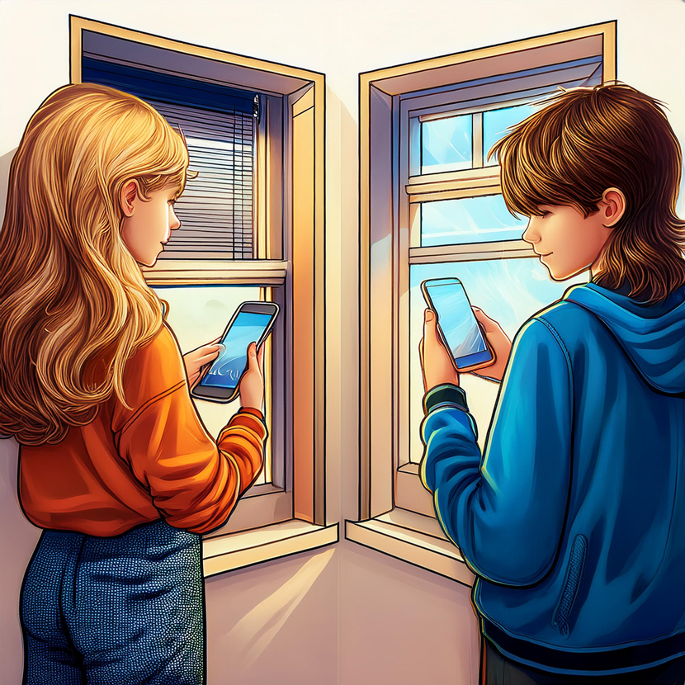

What mistakes do we make?
We share passwords
Hi, give me the password for your... I need access for a while to...

Slide 15

What mistakes do we make?
Passwords that are too short
Most popular PINs
1234 0000 2580 1111 5555 5683 0852 2222 1212 1998

Slide 16
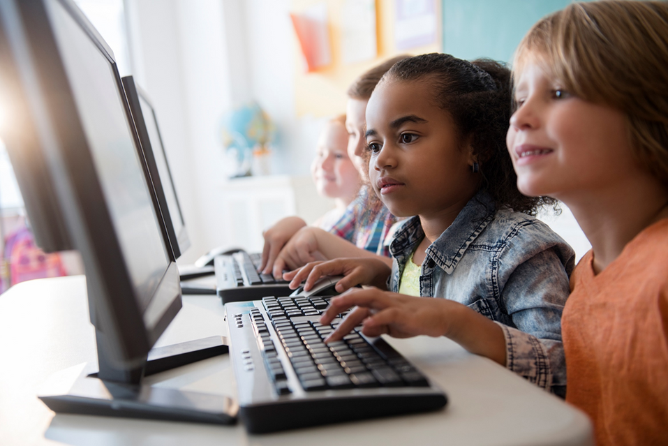
What mistakes do we make?
We use patterns on the keyboard
(np. QWERT)

Slide 17
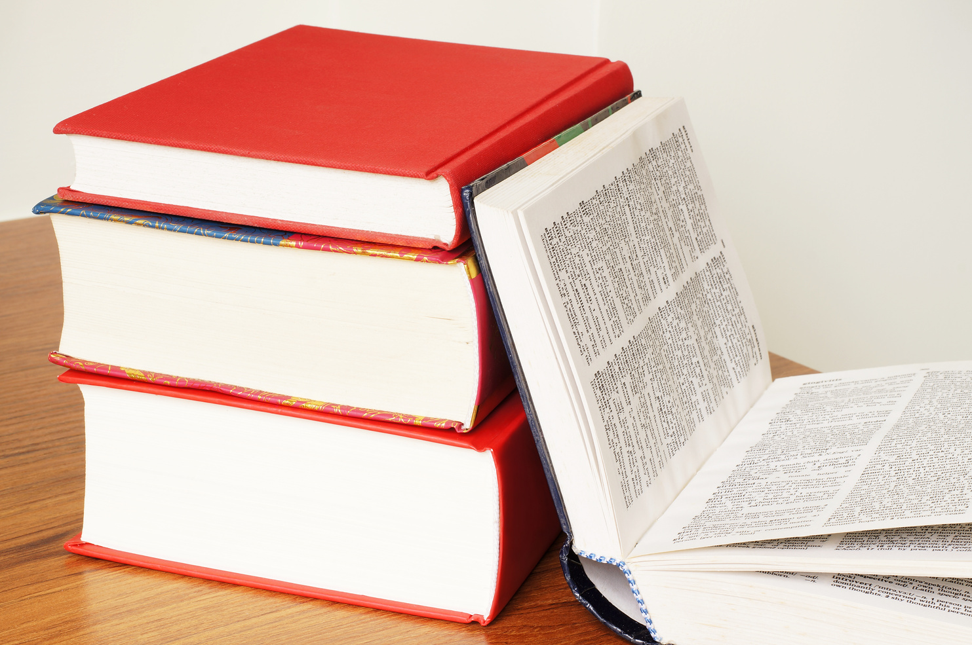
What mistakes do we make?
We use dictionary entries
•Password
•Qwerty
•Sunshine
•Football
•Monkey
•Iloveyou
•Welcome
•Dragon
•Princess
•Chocolate

Slide 18
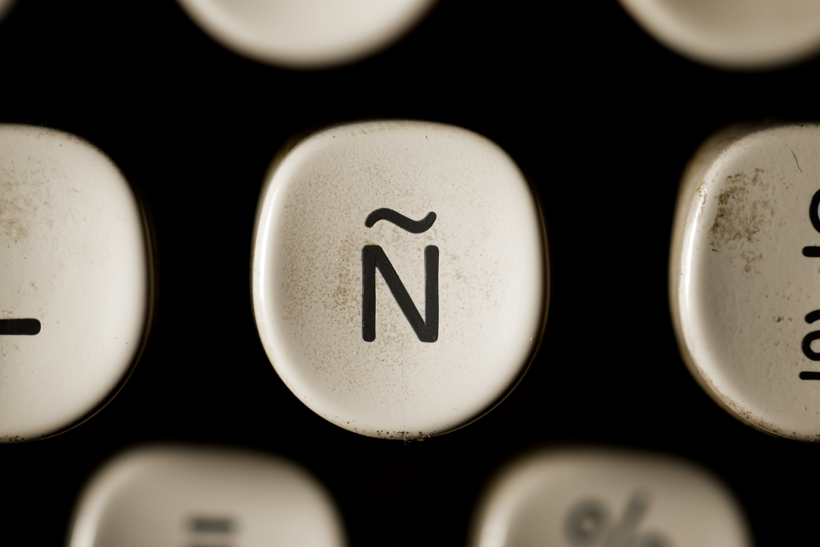
What mistakes do we make?
Substitution of numbers/special characters
•Password → P@$$w0rd
•Qwerty → Qw3r7y
•Sunshine → $un$h1n3
•Football → F00tb@ll
•Monkey → M0nk3y
•Iloveyou → 1L0v3Y0u!
•Welcome → W3lc0m3!
•Dragon → Dr@g0n
•Princess → Pr1nc3$$
•Chocolate → Ch0c0l@t3!

Slide 19
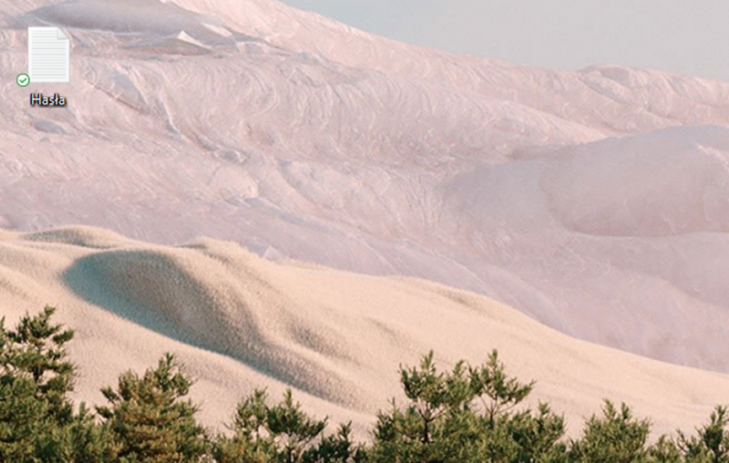
What mistakes do we make?
We store passwords in text files
Notes:
Nie notujemy w plikach, telefonach i na kartkach
Nawet tych zabezpieczonych hasłem

Slide 20
How to be safe?
Worksheet No. 1
As part of the group, think about:
What is causing the problem in this case? Maybe there are several of them?
What do you think could help to counteract such a situation?

Slide 21

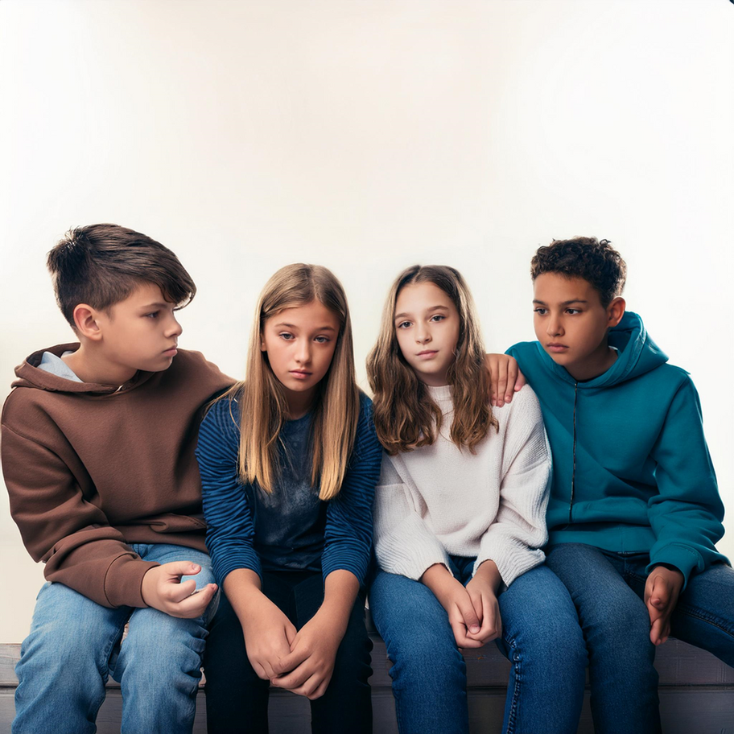
A few stories
Clicking on a suspicious link and taking over your account
Access to your account when you leave your laptop open
Stealing money through a weak password
Losing your game account after sharing your password
Notes:
Kliknięcie podejrzanego linku i przejęcie konta: Kliknąłem w link, który wyglądał jak od znajomego, i wpisałem tam swoje dane logowania. Wtedy ktoś przejął moje konto i teraz nie mam dostępu do ważnych rzeczy.
Dostęp do konta po zostawieniu otwartego laptopa: Zostawiłam otwarty laptop w szkole, a ktoś wszedł na moje konto społecznościowe i opublikował niemiłe rzeczy, udając mnie. Teraz muszę tłumaczyć się nauczycielom i znajomym, bo wszyscy myślą, że to ja.
Kradzież pieniędzy przez słabe hasło: Ustawiłam bardzo proste hasło do mojego konta bankowego i ktoś je złamał, kradnąc wszystkie pieniądze. Teraz muszę walczyć o to, żeby je odzyskać.
Utrata konta w grze po podzieleniu się hasłem: Dałem koledze moje hasło do gry, a on zmienił je i zaczął używać mojego konta. Straciłem wszystkie moje osiągnięcia, nad którymi pracowałem przez długi czas.

Slide 22
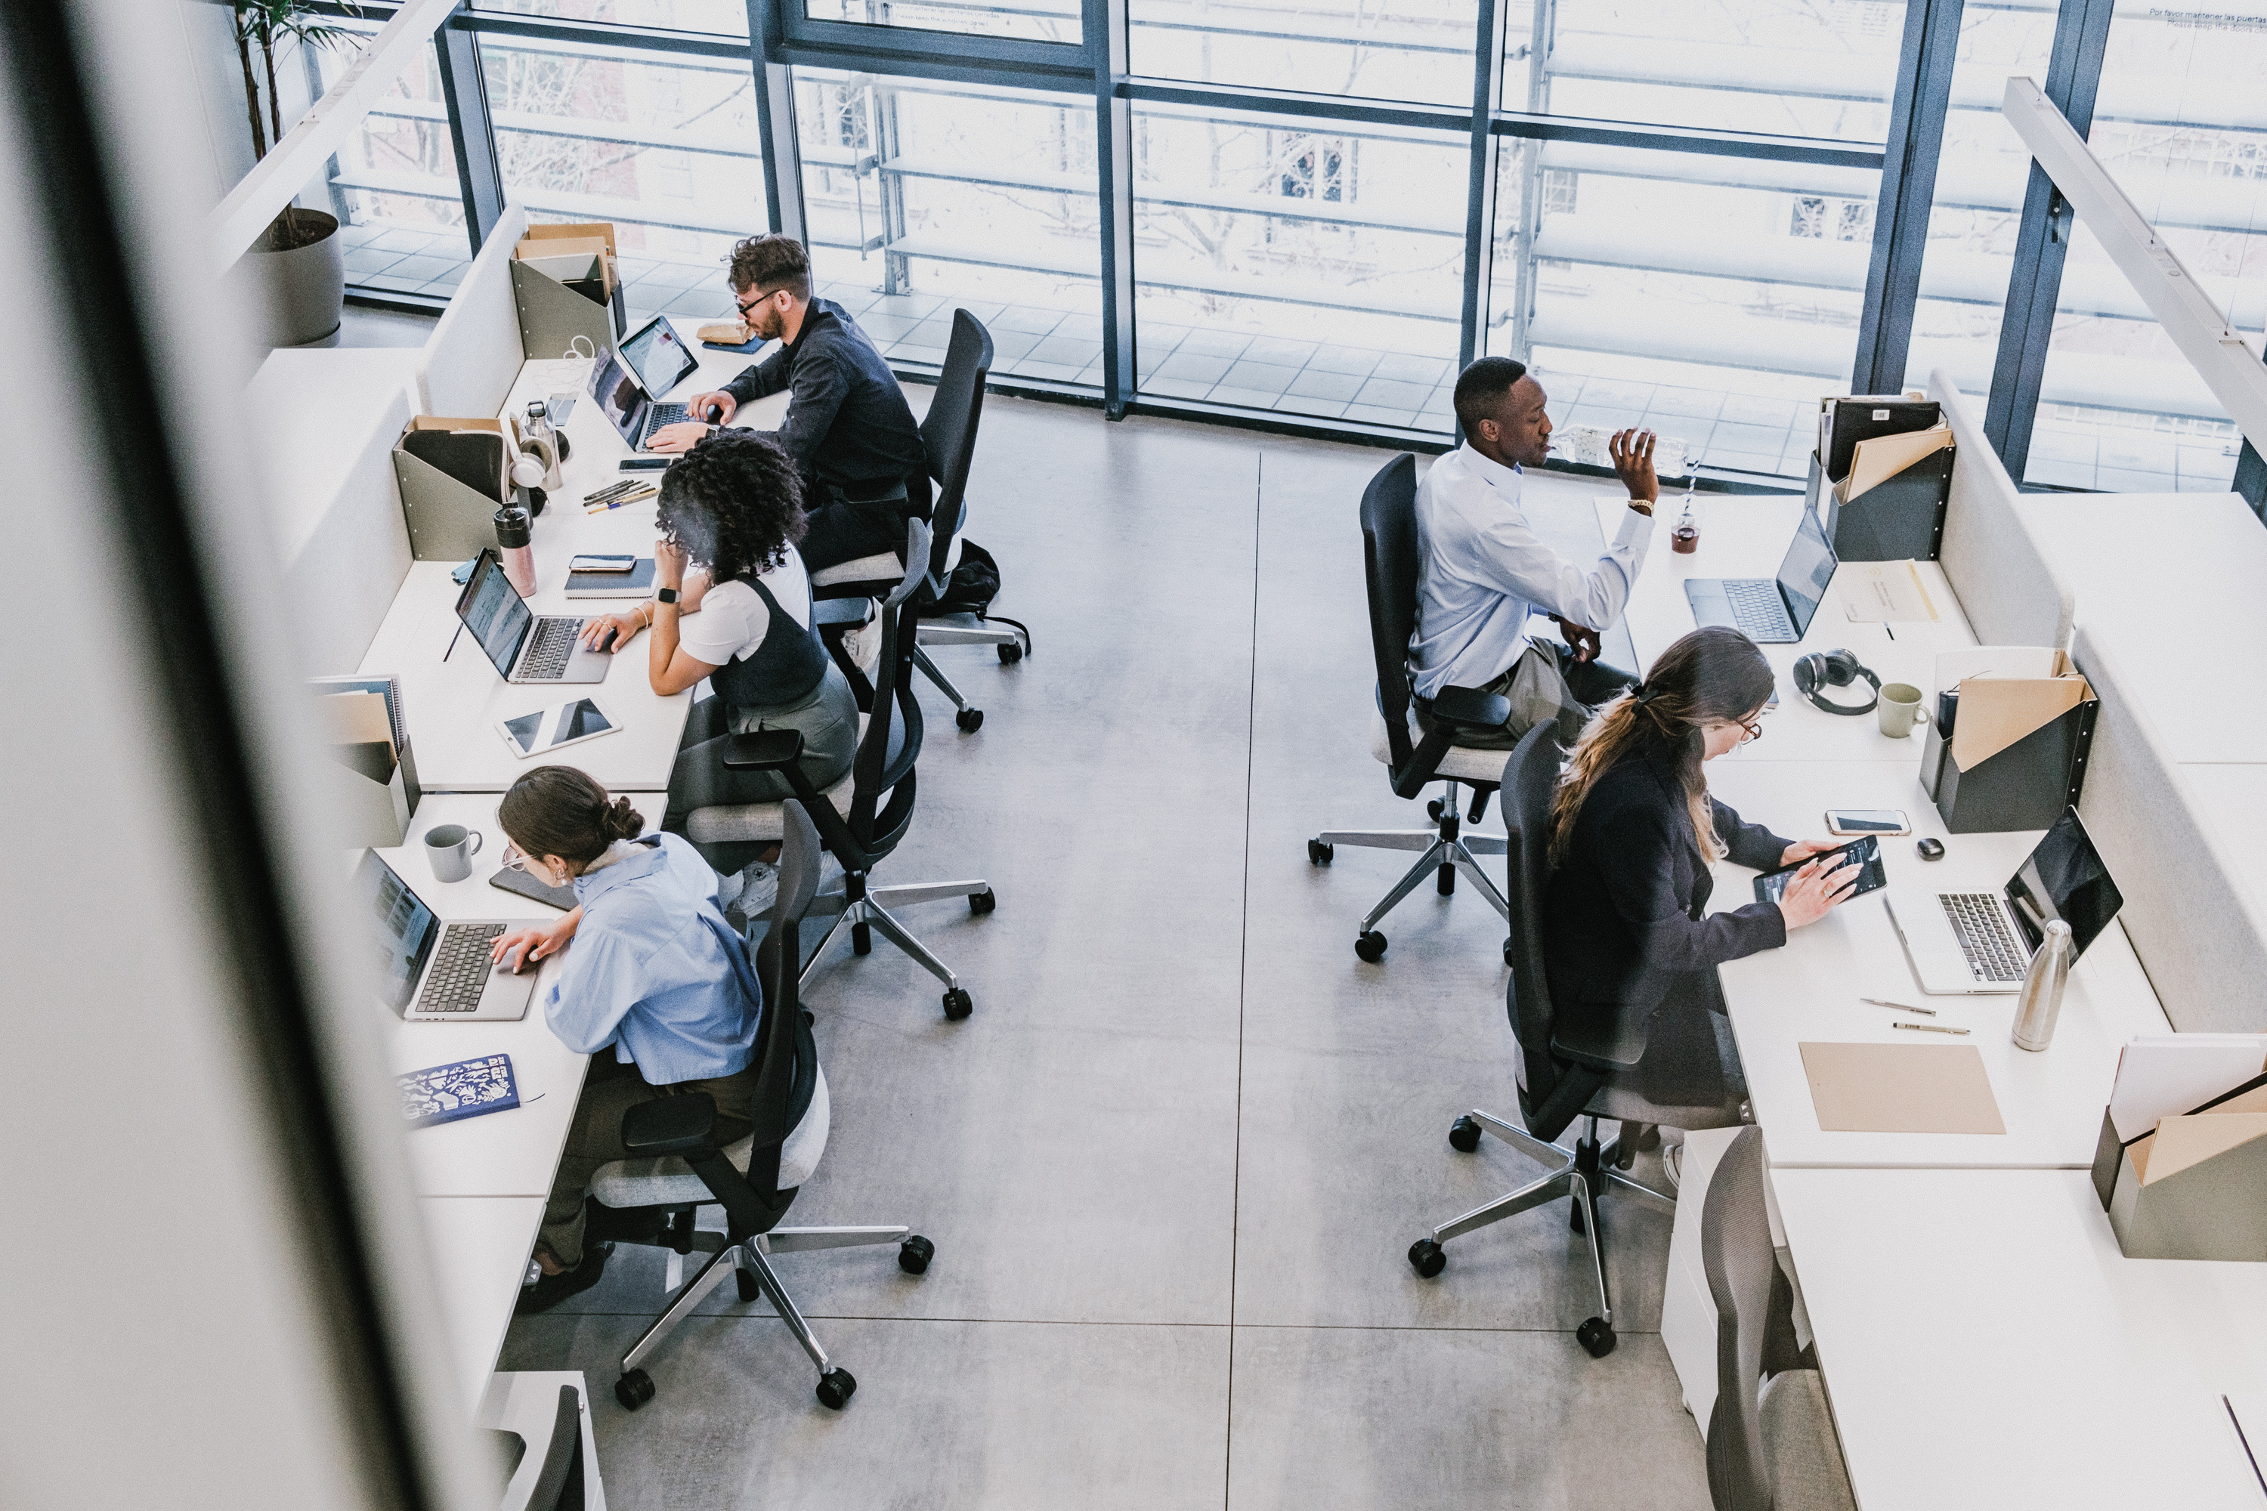
Four steps: How to be safe?

Slide 23
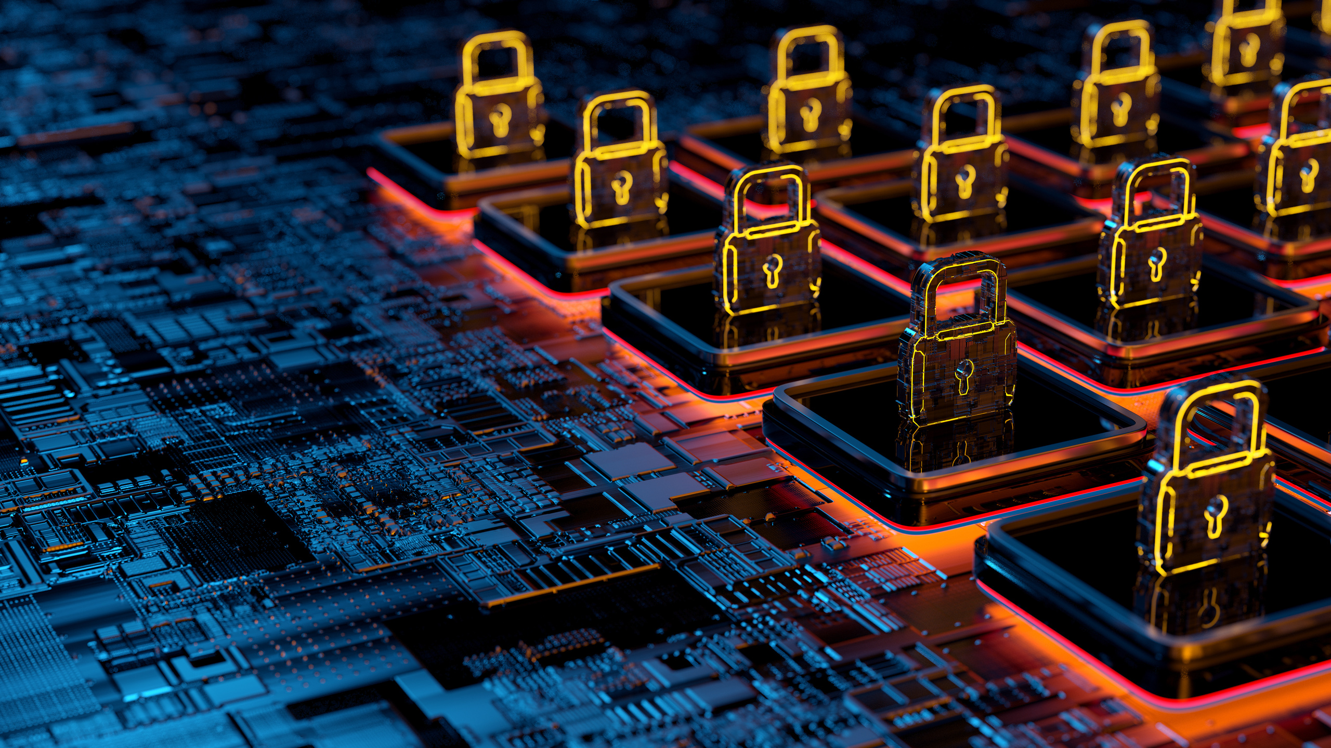
1. Long passwords
Four steps: How to be safe?
Minimum 12 characters. The longer, the better!
Example: T0t@llyS3cur3!2024

Slide 24
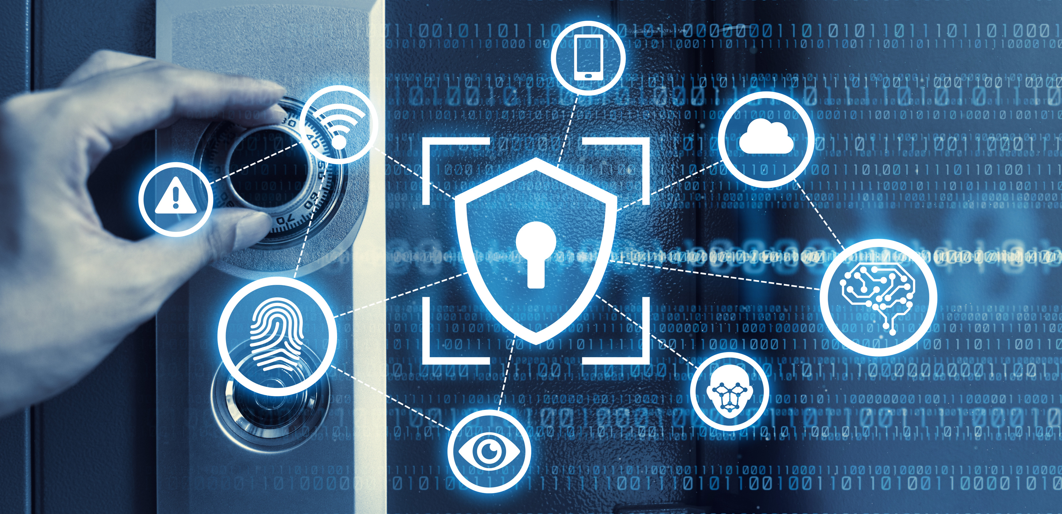
2. Random passwords
Four steps: How to be safe?
Use random, undictionary-based strings and expressions.
Example: G$8w! XpK23z or tepskttuwizoMa

Slide 25
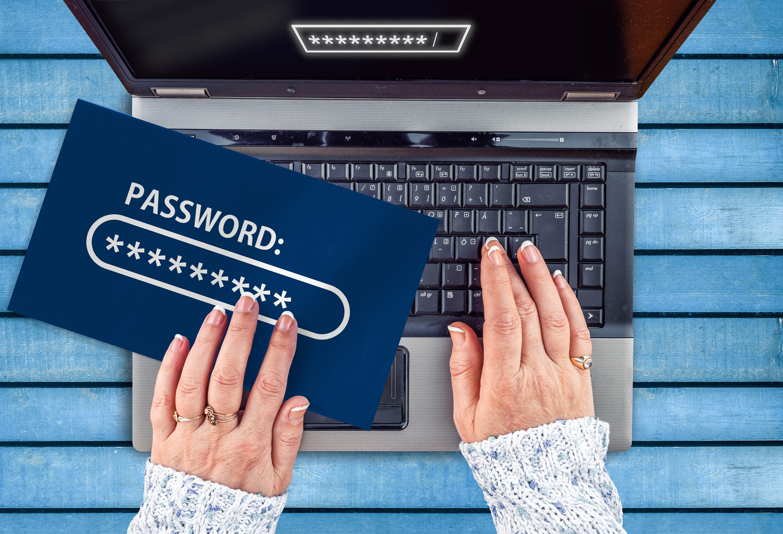
3. Unique passwords
Four steps: How to be safe?
Be creative! Don't use the same password in different places.
Example: Bjuti-Polisz&Inglisz

Slide 26

4. Password Manager
Four steps: How to be safe?
Use password management tools so you don't have to remember them.
Example: LastPass, 1Password, Bitwarden, KeePass XC

Slide 27
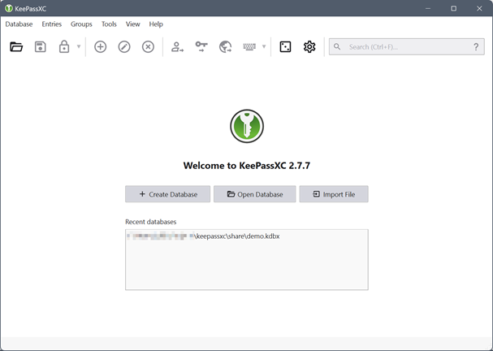
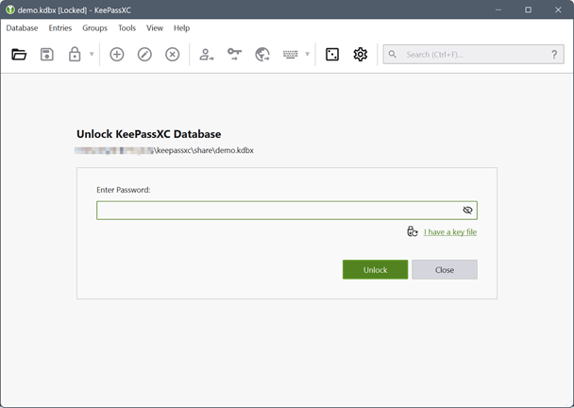
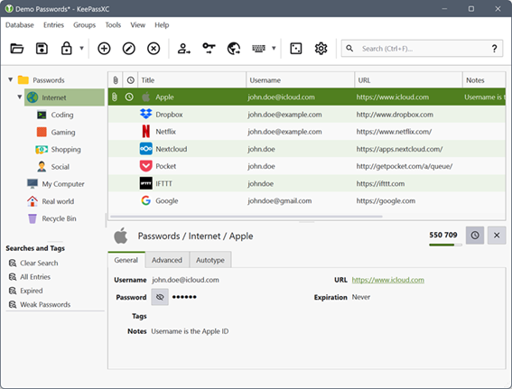
KeePassXC
Install
Create your base
Add passwords and logins
https://keepassxc.org/download/#windows

Slide 28
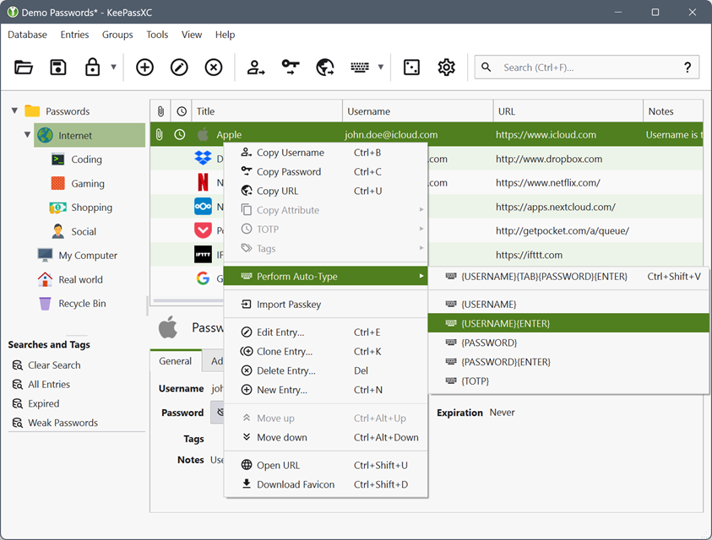
KeePassXC
When using a password manager, it is good to remember:
1) Computer password
2) Password for one mailbox
3) Manager password
https://keepassxc.org/download/#windows

Slide 29
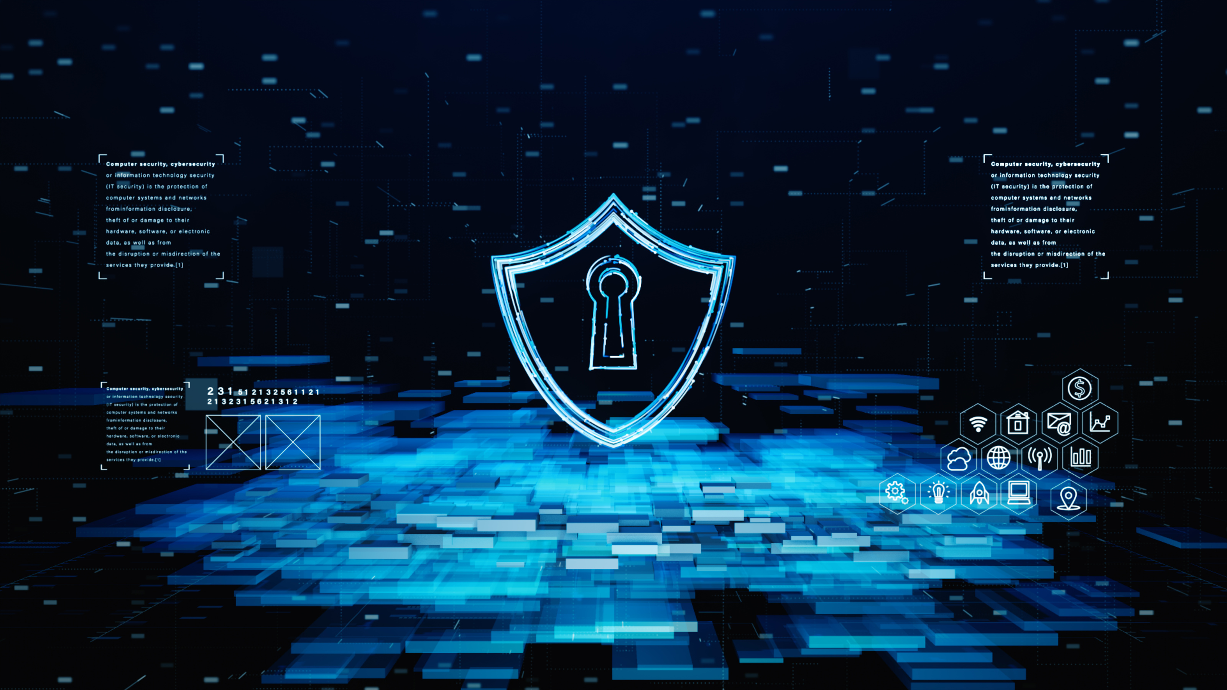
Four steps: How to be safe?
Long passwords
Random passwords
Unique passwords
Password Manager
The key to the security of your accounts!
D-L-U-M

Slide 30

Why use 2FA/MFA?
  2FA/MFA is an additional layer of security:
  In addition to your password, you need one more form of confirmation that it's you.
  What are the additional forms of confirmation?
  SMS code: You get a one-time code on your phone.
  Authenticator app: Generates codes (e.g., Google Authenticator).
  Dongle: A small device that you plug into your computer.
  Fingerprint or facial recognition: Biometric security.
  Why use 2FA/MFA?
  Improved security: Even if someone knows your password, they won't get into your account.
  Hacker protection: Makes it harder for unauthorized people to take over your account.
  Where to enable 2FA/MFA?
  Most services, such as Facebook, Instagram, Gmail, offer this option in the security settings.

Slide 31
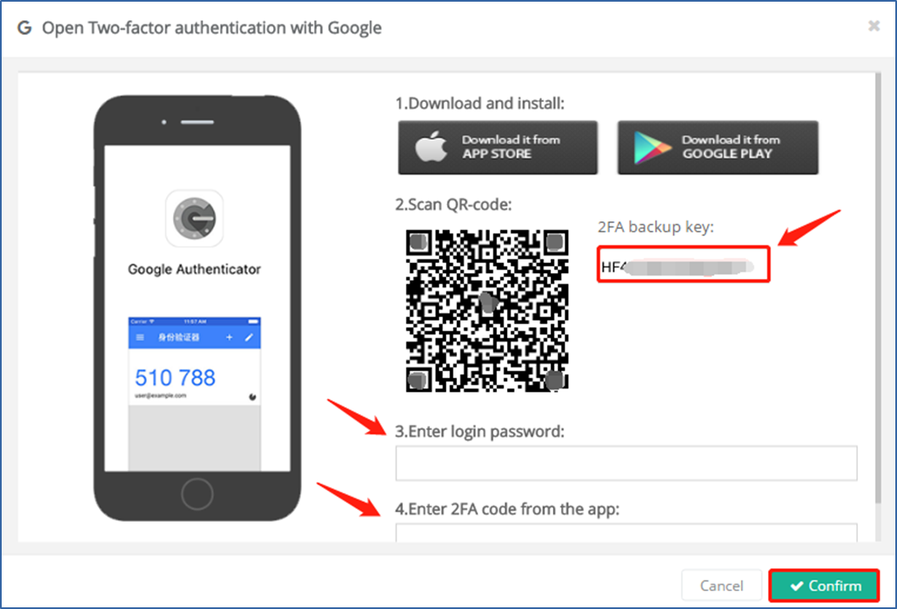
GOOGLE / MICROSOFT AUTENITCATOR

Slide 32

Homework: Secure your accounts
Verify your passwords:
Check that your passwords are long, random, and unique.
Install KeePassXC (or another password manager) on your computer.
Transfer all your passwords to a password manager. Stop writing passwords on sticky notes or text files.
Change weak and dictionary passwords:
If you use simple passwords like "123456" or "password," change them immediately.
Review the systems you use:
Make a list of all the accounts, apps, and systems you use, and make sure they're all secured.
Enable two-factor authentication (2FA):
At least on the most important accounts such as email, social media, banking.
Use apps like Google Authenticator or other available options.

Slide 33

Further information
about the project
https://www.coventry.ac.uk/wroclaw/
https://kreatywnidlabiznesu.pl/cyber-sec-edu-check/
https://eccedu.net/
Funded by the European Union. However, the views and opinions expressed are those of the author(s) only and do not necessarily reflect the views of the European Union or the European Education and Culture Executive Agency (EACEA). Neither the European Union nor the EACEA can be held responsible for them.
All results developed within the framework of this project are available under open licenses (CC BY-NC 4.0). They can be used free of charge and without restrictions. Copying or processing these materials in whole or in part without the author's consent is prohibited. In the case of using results, it is necessary to provide the source of funding and their authors.
PROJEKT NR 2023-2-PL01-KA210-VET-000176822
LEADER:
PARTNERS:

