Slide 1
Lesson 3 Incidents
Responding Effectively to Cyber Incidents
WZMACNIACZ:
LEWADER:
LEADER:
PARTNERS:

Slide 2
Digital Security Incidents
Notes:
Incydent to coś, co wydarzyło się niespodziewanie i mogło spowodować pewne problemy lub trudności. Może to być coś dużego, jak wypadek samochodowy, lub coś mniejszego, jak kłótnia w szkole. Ważne jest, aby zrozumieć, co się stało, dlaczego to się wydarzyło, i jak można to naprawić lub uniknąć podobnych sytuacji w przyszłości.
Na przykład, jeśli w szkole wybuchł mały pożar w kuchni, to incydent. Musimy zrozumieć, co spowodowało ogień, jak można było go uniknąć, i jak teraz zapewnić bezpieczeństwo.

Slide 3
Digital Security Incidents
Losing your game account after sharing your password: Someone has taken over your account and you have lost your game progress, you are having trouble recovering your account
Account hacking: Someone has gained access to your account without your permission.
Malware: Programs that harm your computer, like viruses or ransomware.
Hacking into your bank account: Someone gained access to your account without your permission and transferred money.

Slide 4
Mini Quiz
Check your vulnerability to hackers.
The quiz consists of seven questions.
Select the answer that best suits your opinion.
Write down your answers.

Slide 5
a
No, because I don't have any important data that can be sold
1. Can someone want to attack you?
Yes, because someone can use my social media account to deceive others
b
c
Yes, because someone can encrypt my data and demand a ransom

Slide 6
a
Yes, because they are easier to remember
2. Do you use the same password for several different accounts?
b
No, I have a unique password for each account
c
I use one master password and minor modifications on other accounts

Slide 7
a
Not always, I usually click if the sender looks familiar
3. Do you verify the sources of the links you receive in emails or messages?
b
I always check if the link is safe before clicking
c
Only if the message seems suspicious

Slide 8
a
I ignore it or delete it
4. What do you do when you receive a suspicious email asking for your data?
b
I check the sender's details and links before I make a decision
c
I open but do not enter any data

Slide 9
a
I don't use any additional security features
5. What steps do you take to protect your devices?
b
I have an antivirus installed and I update it regularly
c
I use an antivirus, update my software, and use a password manager

Slide 10
a
No, no one will want my data
6. Do you think your personal information is valuable to others?
b
Yes, they can be used for identity theft or fraud
c
Only my bank details or passwords are valid

Slide 11
a
Nothing, maybe it's a mistake
7. What do you do when you see suspicious activity on your account?
b
I change my password immediately and check my other accounts
c
I wait and see if the situation repeats itself

Slide 12
Quiz result
The advantage of the "a" answer: You have a lot to improve, hackers can take advantage of your weak security. Increase awareness of threats and introduce better habits.
Advantage of "b" answer: You are well prepared and aware of the risks, but it is always worth deepening your knowledge of online security.
Advantage of "c" answer: You have basic knowledge, but there is still room for improvement. Work to strengthen the security of your accounts and devices.

Slide 13
Who is a hacker?
Expectations vs Reality
Notes:
Oczekiwania:
Filmowy obraz: Często wyobrażamy sobie hackerów jako osoby w kapturach, które potrafią złamać każdy system komputerowy.
Superbohaterowie: Wyglądają na bardzo inteligentnych i działają w ciemnościach, aby zdobyć tajne informacje.
Rzeczywistość:
Różne rodzaje hackerów: Są różne typy hackerów, w tym tacy, którzy pomagają w poprawie bezpieczeństwa (tzw. "białe kapelusze") i tacy, którzy robią coś nielegalnego (tzw. "czarne kapelusze").
Umiejętności i narzędzia: Hackerzy używają specjalnych narzędzi i technik, ale ich działania są często bardziej techniczne niż w filmach. Nie zawsze działają w tajemnicy. Często wykorzystują socjotechniki.
Socjotechnika to techniki manipulacji, które mają na celu uzyskanie informacji lub dostępu do systemów poprzez oszukiwanie ludzi, a nie łamanie zabezpieczeń komputerowych.
Przykłady socjotechnik:
Phishing: Osoba próbuje zdobyć twoje dane, wysyłając fałszywe e-maile, które wyglądają jakby były z zaufanego źródła, np. z banku.
Pretexting: Ktoś udaje, że jest kimś innym (np. pracownikiem firmy), aby uzyskać od Ciebie ważne informacje, jak hasło czy numer telefonu.
Dlaczego socjotechniki są skuteczne?
Psychologia: Ludzie często nie zdają sobie sprawy, że są oszukiwani, i mogą dać się łatwo nabrać, jeśli ktoś podaje się za osobę, której ufają.
Jak się chronić?
Nie ufaj każdemu: Zawsze sprawdzaj, czy osoba, która pyta o twoje dane, jest rzeczywiście tym, za kogo się podaje.
Nie klikaj w podejrzane linki: Jeśli otrzymasz e-mail lub wiadomość, która wydaje się dziwna, nie klikaj w linki i nie podawaj swoich danych osobowych.

Slide 14
Cracking passwords
Link: https://www.hivesystems.com/password-table

Slide 15
Leak monitoring
Have I Been Pwned https://haveibeenpwned.com/
A popular tool to check if your email or password has been in data leaks.
DeHashed https://www.dehashed.com/
A data leak finder that lets you see if your data has been exposed. It also offers more advanced features in the paid version.
BreachAlarm https://breachalarm.com/
A password leak checker and monitor if your data has been compromised.

Slide 16
Have I been pwned?

Slide 17
You receive an email
Imagine that you have just found out that your password has been exposed and your account has been compromised. This could be due to a hacker attack, a data leak from a service, or even an accidental password disclosure
What happens when you find out about such an incident?
How do you react?
What do you think, what do you feel, and what do you do?
Group work
Sharing a story

Slide 18
What to do in case of a password leak?
1. Change your password as soon as possible
The sooner you change your password, the less chance that someone will take advantage of your account.
How: Go to the website or app, log in, go to settings and change your password to a new, strong password.
2. Verify active logins
Checking where you are logged in allows you to log out potentially dangerous sessions.
How To: In your account settings, find the "Active Sessions" or "Devices" section and see what places and devices you're logged in from. Log out of suspicious sessions.
3. Change all similar passwords
If you use similar passwords on other accounts, change them to avoid other accounts being compromised by people who have obtained one of your passwords.
How To: Make sure each account has a unique password that is not like any other.

Slide 19
What to do in case of a password leak?
4. Enter multi-factor authentication (2FA)
Multi-factor sign-in provides an extra layer of security, even if someone knows your password.
How: Enable 2FA in your account settings by selecting the option to add a second factor, e.g. an SMS code, an authentication app (e.g. Google Authenticator), or a dongle.
5. Get started with a password manager
A password manager will help you generate and store strong, unique passwords for each account.
How: Install a password manager (e.g., KeePassXC, LastPass) and transfer all your passwords to it. Use it to autofill passwords when you log in.

Slide 20
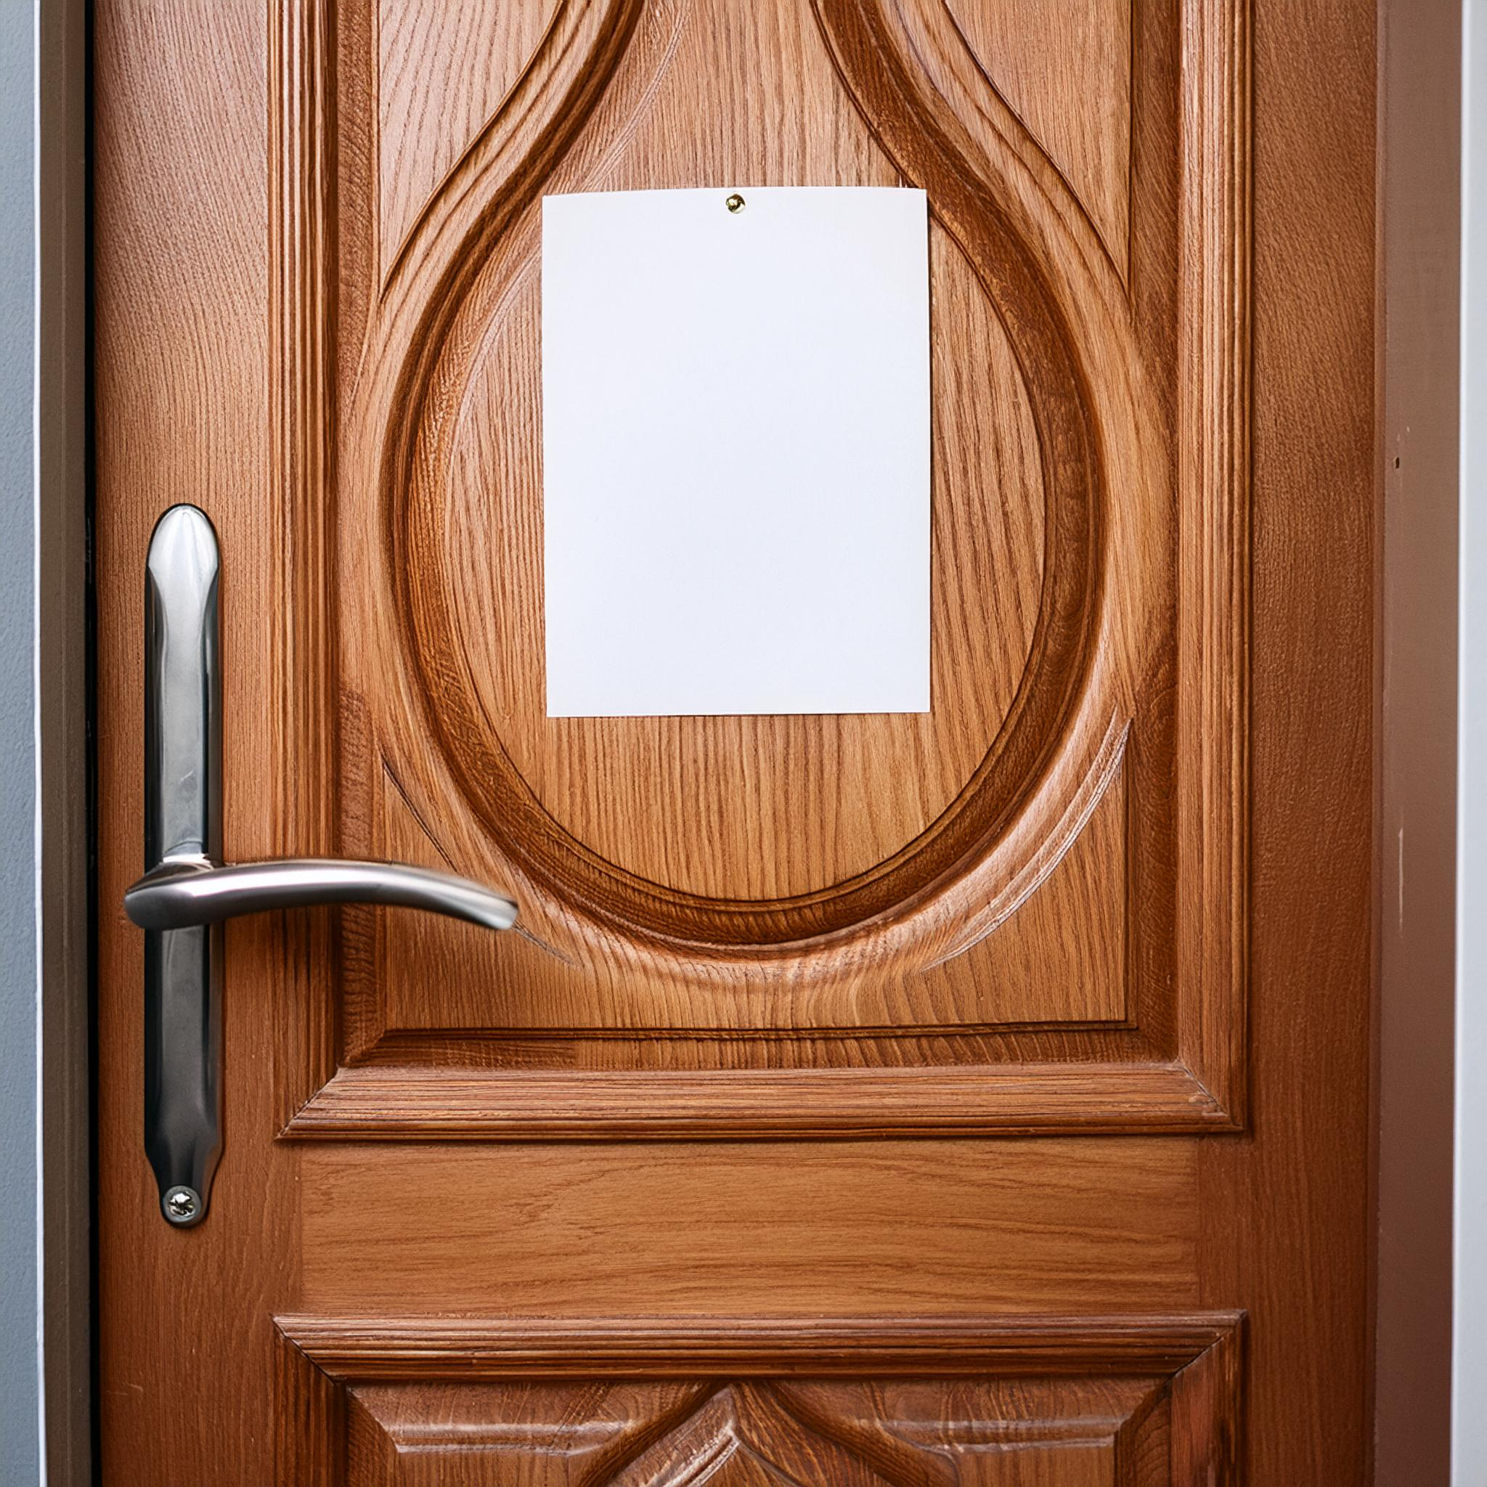
Ransomware
It's a type of malware that blocks access to your files on your computer and demands a ransom to unlock them.
It looks like someone locked you in a room and demanded money to let you go.
Zapłać !!!

Slide 21
Ransoware Protection
Regular backups: Store important files on an external drive or in the cloud. If your computer gets infected, you can restore your files from a backup.
Software updates: Make sure your operating system and all programs are always up to date. New updates often fix security vulnerabilities.
Antivirus: Install and use an antivirus program that can detect and block threats.
Safe Surfing: Don't click on suspicious links or download files from unknown sources.
Education: Learn to recognize suspicious emails and messages that may contain malware.

Slide 22
Ransomware Protection
Windows Update -> advanced options -> software protection ransomware

Slide 23
Data Backup
You make a copy of your important files and store it in a safe place.
If something goes wrong with your computer or phone, you can use that copy to recover your data.

Slide 24
Principle 3-2-1
3 copies of your data: Have at least three copies of your data. One copy is the original and the others are backups.
2 different media: Store these copies on two different types of media. For example, one copy on your computer and another on an external hard drive.
1 offline backup: Have at least one backup that isn't connected to the internet to keep it safe even if your computer gets infected with a virus.

Slide 25
Homework: Incident Management
Check your email addresses:
Use the Have I Been Pwned service and check if your email addresses have been involved in data leaks.
Make a list of email addresses that have been leaked.
Stay informed about new leaks:
Use the Have I Been Pwned notification for new leaks. Enter your email addresses to be notified of future leaks related to these addresses.
Follow e.g. : CERT Polska (@CERT_Polska) / X and niebezpiecznik.pl
Change passwords:
Change the passwords of the accounts that were involved in the leaks. Use strong, random passwords. You can use a password manager like KeePassXC to generate and store new passwords.
Create backups:
All you need to do is copy your precious files to a portable USB drive and keep it in a safe place.

Slide 26
Social Media

Slide 27
Threats
Social engineering and phishing attacks: Don't click on suspicious links or attachments in messages. Be wary of people who try to get your personal information under the pretense of helping.
Oversharing: Don't share private information such as your home address, phone number, or login information. Think before you share photos or location.
Data collection: Apps can collect your personal information even if you don't expect it. Check your privacy settings.
Unmonitored accounts: Check and update your privacy settings regularly. Secure your accounts with strong passwords and enable two-factor authentication.
Fraudulent sites: Make sure you only visit websites and apps you trust. Check the URL before providing any data.

Slide 28
Conscious use, sometimes we forget...
Thoughtful message sharing: Before you send a message, consider whether it is secure and free of private data. Avoid sharing information that could be used for scams or harassment.
Keep your devices secure: Install antivirus software and keep it up to date. Use strong passwords and avoid using the same passwords across accounts. Protect your devices with a password, PIN or fingerprint.
Verify your friendliness: Only accept friend requests from people you really know. Regularly review your friends list and remove people you don't know.
Verify privacy settings: Regularly check and update the privacy settings on your profiles. Set who can see your posts, photos, and other information. Enable security features like two-factor authentication to further protect your accounts.

Slide 29
Further information
about the project
https://www.coventry.ac.uk/wroclaw/
https://kreatywnidlabiznesu.pl/cyber-sec-edu-check/
https://eccedu.net/
Funded by the European Union. However, the views and opinions expressed are those of the author(s) only and do not necessarily reflect the views of the European Union or the European Education and Culture Executive Agency (EACEA). Neither the European Union nor the EACEA can be held responsible for them.
All results developed within the framework of this project are available under open licenses (CC BY-NC 4.0). They can be used free of charge and without restrictions. Copying or processing these materials in whole or in part without the author's consent is prohibited. In the case of using results, it is necessary to provide the source of funding and their authors.
PROJEKT NR 2023-2-PL01-KA210-VET-000176822
LEADER:
PARTNERS:

