Slide 1
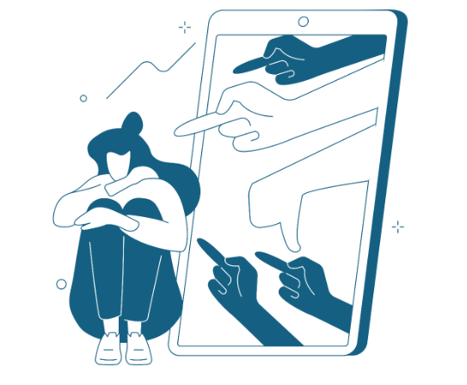
Lesson 4 Cyberbullying
Recognizing and Addressing Harmful Online Behavior
WZMACNIACZ:
LEWADER:
LEADER:
PARTNERS:

Slide 2
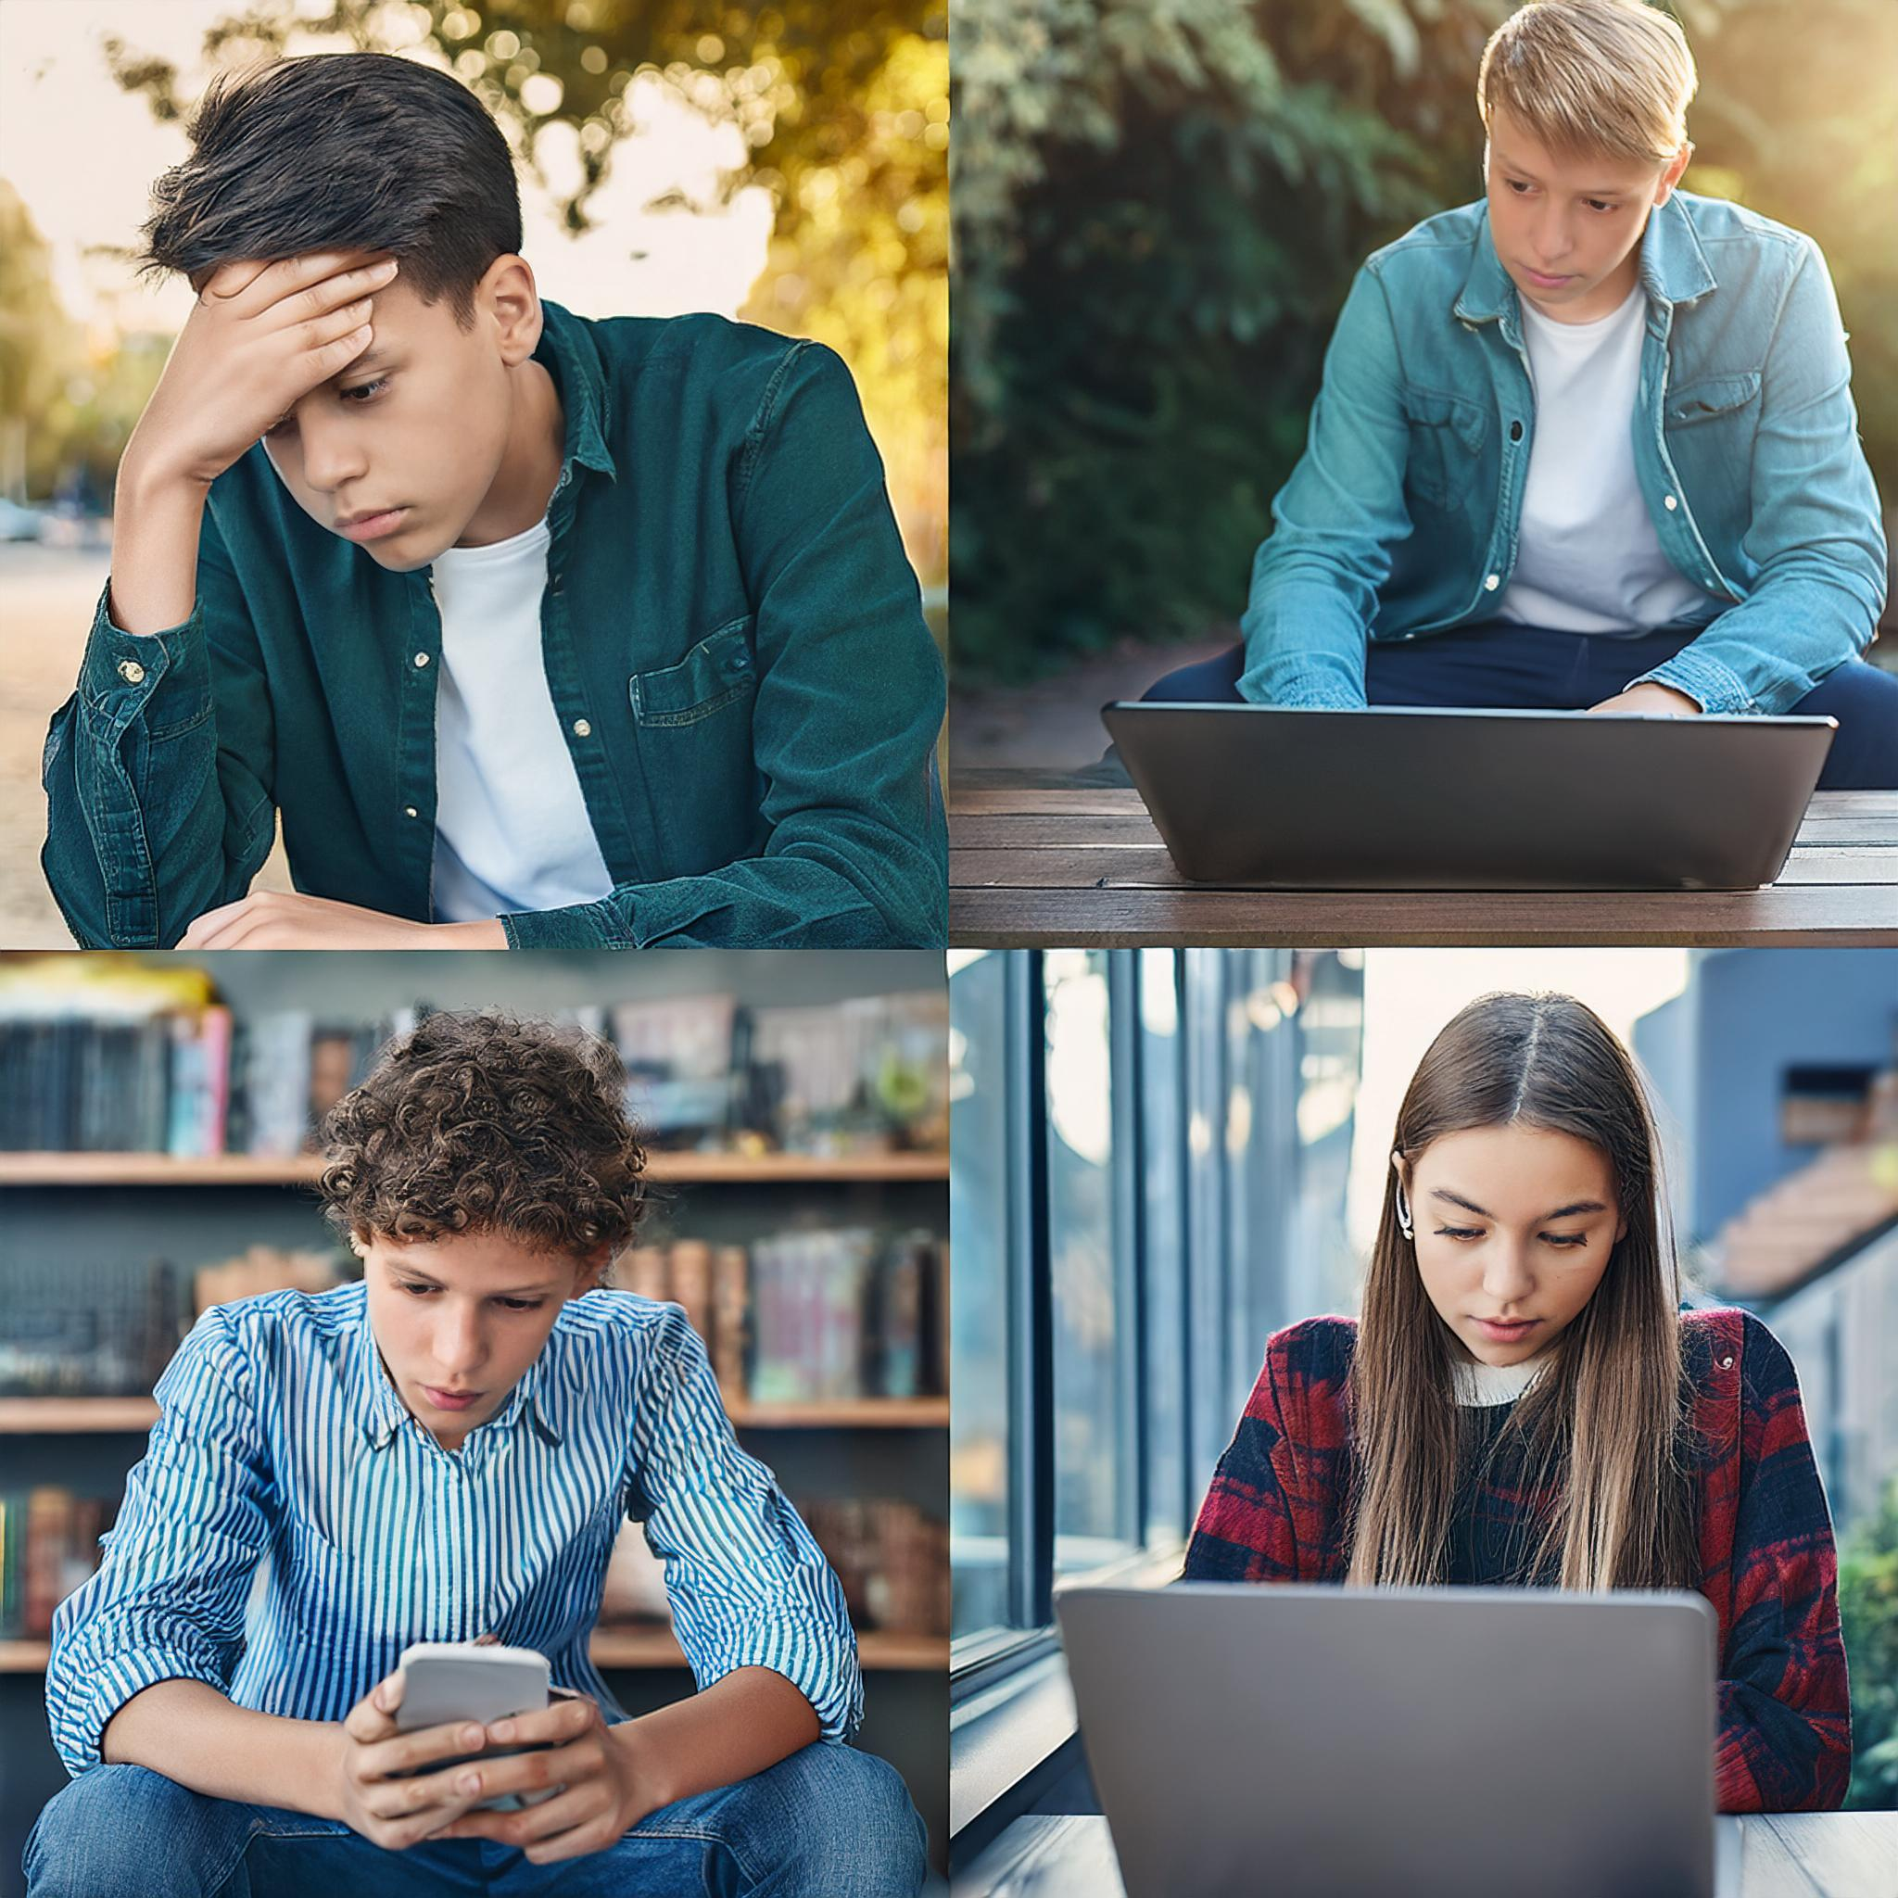
What is Cyberbullying?

Slide 3
What is Cyberbullying?
Cyberbullying is violence with the use of electronic devices, such as a phone or computer.

Slide 4
Is cyberbullying ...?

Slide 5
Offender
Three roles
Victim
Witness

Slide 6
Group Activity
Students are divided into three groups, each group has one (the same) task: to tell the teacher that they know about the situation of cyberbullying against a classmate. Cyberbullying involves creating offensive memes and sending them along with gossip to students of other classes.
Division of groups:
In groups:
1 group – victims;
2nd group – witnesses;
Group 3 – offender who no longer want to participate in the harassment of a colleague
think about how you feel before talking to the teacher;
write down the first 3-5 sentences that you plan to say to the teacher;
think about what you will say when the teacher asks you: why are you reporting this only now?

Slide 7
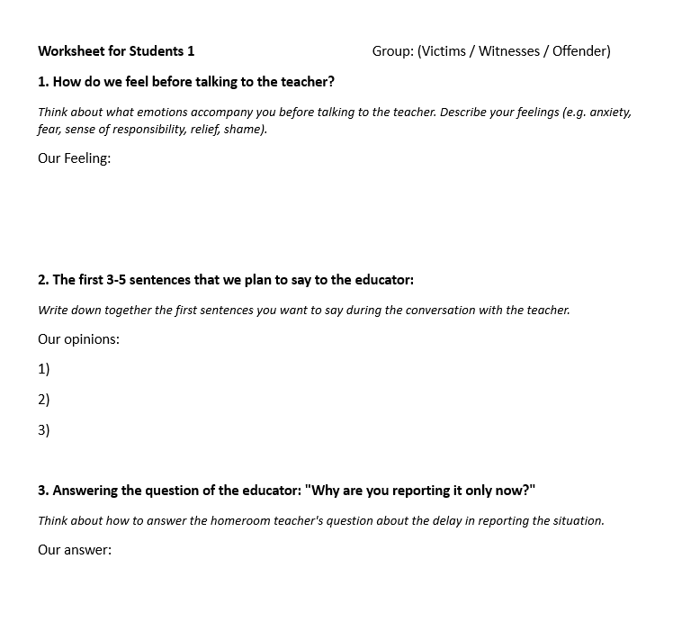
Worksheet

Slide 8
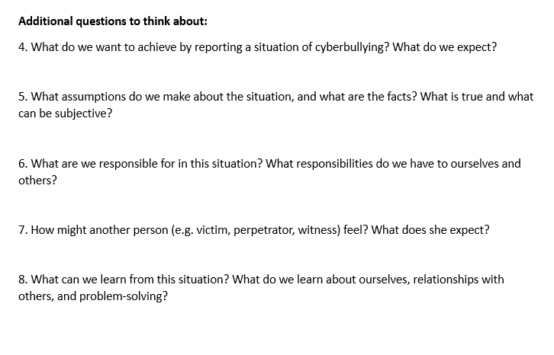

Slide 9
Discussion of the results and discussion

Slide 10
Summary of Key Points
What to do when we witness or are a victim of cyberbullying?
What actions can perpetrators take to correct their mistakes?

Slide 11
Criminal liability
After the age of 10:
proceedings are conducted against the child in a case for demoralization under the Act of 9 June 2022 on the support and rehabilitation of minors
After the age of 13:
is responsible for crimes under the Act of 9 June 2022 on the Support and Rehabilitation of Juveniles
After the age of 17:
you are responsible for crimes under the Penal Code as a juvenile

Slide 12
Where to look for support
116 111, www.116111.pl
This support phone works in Polish and Ukrainian.
Our conversations and correspondence are confidential. This means that we don't tell anyone what we talked about.
In the event of a life or health emergency, we will contact the people who will take care of your safety.
The phone works every day, 24/7

Slide 13
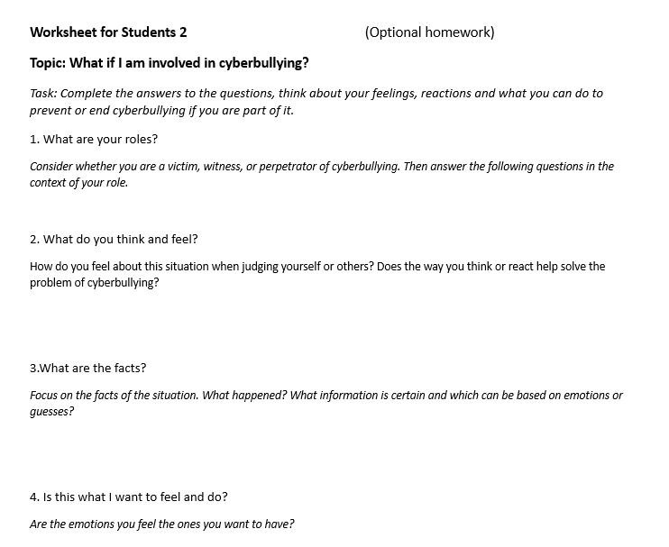
What if I'm caught up in "it"?

Slide 14
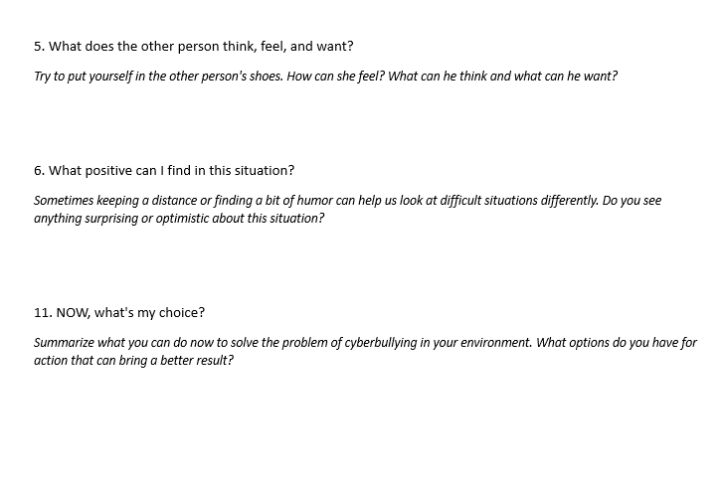
What if I'm caught up in "it"?

Slide 15
Further information
about the project
https://www.coventry.ac.uk/wroclaw/
https://kreatywnidlabiznesu.pl/cyber-sec-edu-check/
https://eccedu.net/
Funded by the European Union. However, the views and opinions expressed are those of the author(s) only and do not necessarily reflect the views of the European Union or the European Education and Culture Executive Agency (EACEA). Neither the European Union nor the EACEA can be held responsible for them.
All results developed within the framework of this project are available under open licenses (CC BY-NC 4.0). They can be used free of charge and without restrictions. Copying or processing these materials in whole or in part without the author's consent is prohibited. In the case of using results, it is necessary to provide the source of funding and their authors.
PROJEKT NR 2023-2-PL01-KA210-VET-000176822
LEADER:
PARTNERS:

