Slide 1
Lesson 5 True or False?
Identifying and Combating Digital Disinformation
WZMACNIACZ:
LEWADER:
LEADER:
PARTNERS:

Slide 2
Stereotypes
Notes:
Czy te historie są prawdziwe?
Nie. Co nie znaczy, że nie mogły się wydarzyć

Slide 3
Explanation of terms Propaganda
It is a way of conveying information that aims to convince people of an idea or view.
Propaganda often uses emotions to influence what we think and feel.
It can be used in politics, media, or advertising to urge people to take a certain action or change their minds.

Slide 4
Disinformation
It is deliberately giving false information to confuse or deceive others.
Disinformation looks like real news, but it's meant to mislead people.
It is used to harm someone or gain benefits, for example in politics or the Internet.

Slide 5
Different target groups

Slide 6
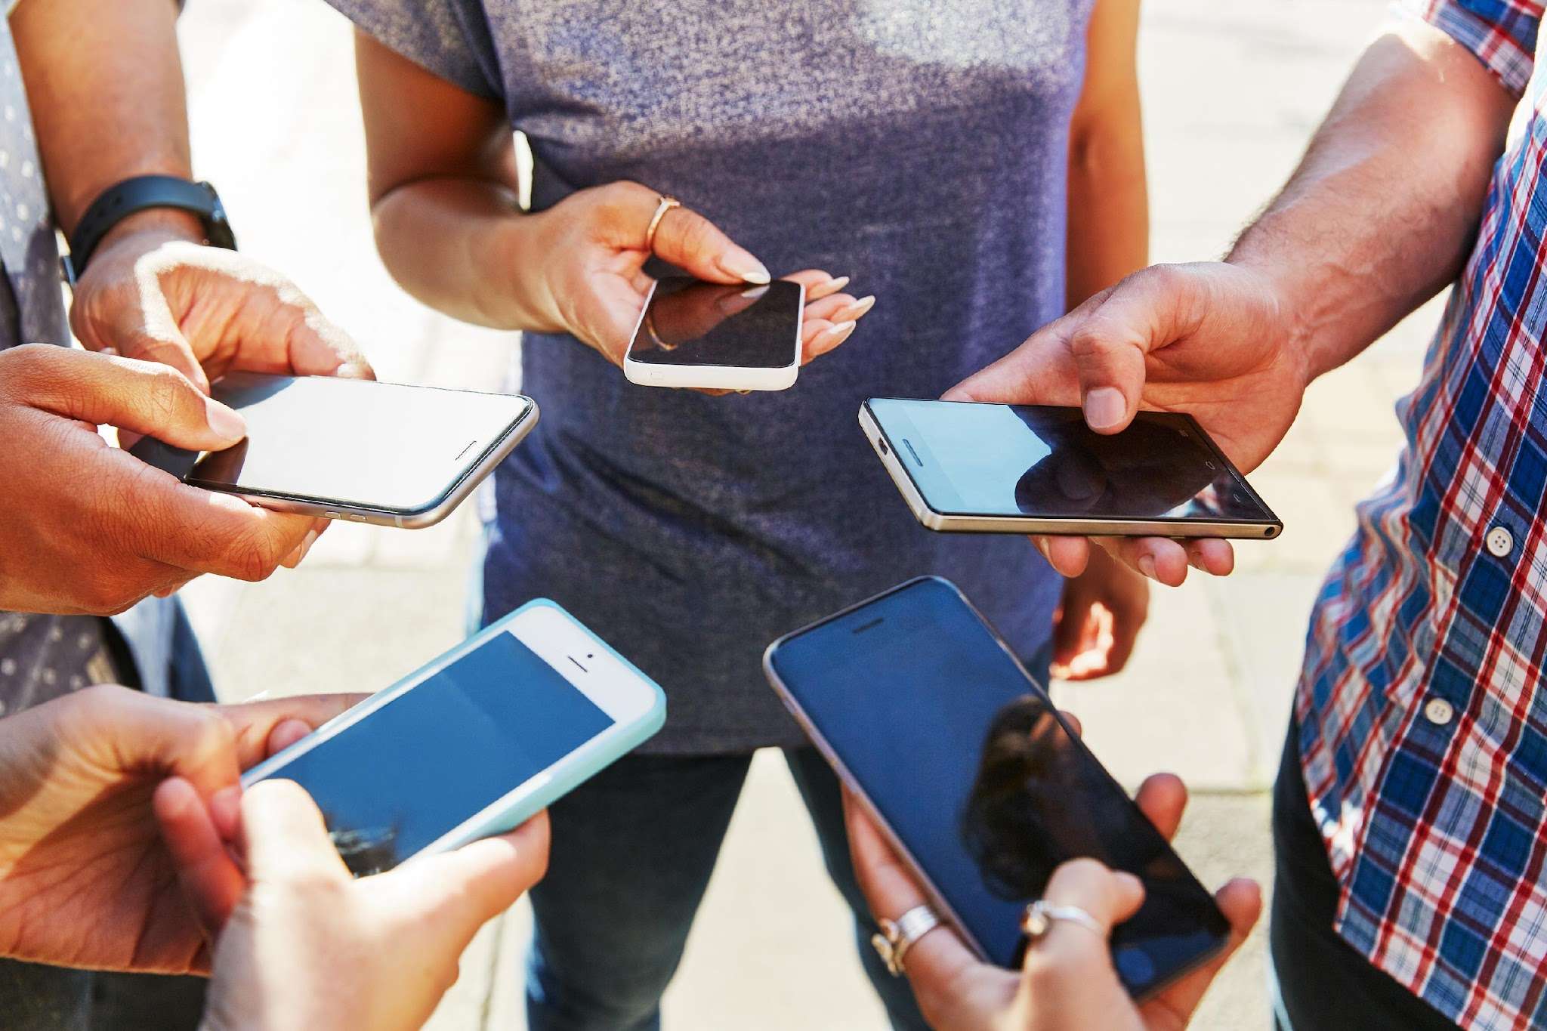
What is Prevention?
Notes:
Czy te historie są prawdziwe?
Nie. Co nie znaczy, że nie mogły się wydarzyć

Slide 7
Countering
Prevention is the action to protect against false or manipulated information that tries to influence our thinking and behavior
We learn to recognize false information and not to succumb to emotions or beliefs that are deliberately distorted
It protects us from manipulation so that we can make independent and informed decisions, based on facts

Slide 8
Interpretation
Event
Reaction
Emotional
and behavioral
Emotions

Slide 9
Strong emotions
Information that evokes strong emotions (such as anger or fear) is better remembered and shared more willingly.
The influence of emotions on receiving information (stressed vs. relaxed).

Slide 10
Game Interpretation
Understand how nonverbal communication can affect the interpretation of information and the potential consequences of misinterpretation.
Division of groups:
1 group – participants; 2nd group – observers;
Participants will make movements and observers will analyze changes in interpretation.
Course of the exercise:
In a group of participants, choose one person who will show a simple non-verbal movement at the beginning (e.g. waving their hand, jumping in place, turning around themselves).
Students in this group must observe the movement and repeat the last seen movement, passing it one by one to the next person in the line.

Slide 11
Our Responsibility
The sender should communicate the messages clearly, and the recipient should analyze them carefully.
There are differences in responsibility: the sender must be credible and the receiver must be critical of the message.
Factors such as emotion, context, and experience can influence our interpretation of information.
Any of us can accidentally spread misinformation when we share unverified information.
Each of us is responsible for understanding the information we receive.
Notes:
Kliknięcie podejrzanego linku i przejęcie konta: Kliknąłem w link, który wyglądał jak od znajomego, i wpisałem tam swoje dane logowania. Wtedy ktoś przejął moje konto i teraz nie mam dostępu do ważnych rzeczy.
Dostęp do konta po zostawieniu otwartego laptopa: Zostawiłam otwarty laptop w szkole, a ktoś wszedł na moje konto społecznościowe i opublikował niemiłe rzeczy, udając mnie. Teraz muszę tłumaczyć się nauczycielom i znajomym, bo wszyscy myślą, że to ja.
Kradzież pieniędzy przez słabe hasło: Ustawiłam bardzo proste hasło do mojego konta bankowego i ktoś je złamał, kradnąc wszystkie pieniądze. Teraz muszę walczyć o to, żeby je odzyskać.
Utrata konta w grze po podzieleniu się hasłem: Dałem koledze moje hasło do gry, a on zmienił je i zaczął używać mojego konta. Straciłem wszystkie moje osiągnięcia, nad którymi pracowałem przez długi czas.

Slide 12
Think before you share!
Let's share only reliable news to improve the quality of information in our environment
https://youtu.be/pQsoS-1_WEE?si=WIOp6Urwi9Xq5Hu-

Slide 13
Summary of key points
Disinformation is the deliberate spread of false information that can influence our thinking and decisions
Strong emotions can increase belief in false information and make it easier for us to spread it
Critical thinking is key in recognizing misinformation and separating fact from opinion
Reliability of sources is essential – it is always worth checking who the author of the information is and whether they are experts in a given field
Translating messages and passing them on can change their meaning – it is worth considering the original meaning of the text
Conscious sharing of information – before you share something online, make sure the information is true

Slide 14
ABCD method
Step 1: A – Aware
Stop and pay attention to what you just read or heard. Do you feel strong emotions such as anger, fear, or excitement? Does this information seem suspicious?
Step 2: B – Breathe
Take a deep breath. This will allow you to calm down and gain a moment not to react immediately. Remember that the first reaction to information can be emotional. Step 3: C – Curious
Be curious, but in a positive way. Ask yourself: Where does this information come from? Is the source reliable? Do others confirm this? This may be the time to conduct a short study or verify the data.
Step 4: D – Decide
Once you've examined the information, decide what to do. Should you believe and share this information? Or maybe it is better to ignore it? Choose a conscious response instead of a reaction to emotions.

Slide 15
Further information
about the project
https://www.coventry.ac.uk/wroclaw/
https://kreatywnidlabiznesu.pl/cyber-sec-edu-check/
https://eccedu.net/
Funded by the European Union. However, the views and opinions expressed are those of the author(s) only and do not necessarily reflect the views of the European Union or the European Education and Culture Executive Agency (EACEA). Neither the European Union nor the EACEA can be held responsible for them.
All results developed within the framework of this project are available under open licenses (CC BY-NC 4.0). They can be used free of charge and without restrictions. Copying or processing these materials in whole or in part without the author's consent is prohibited. In the case of using results, it is necessary to provide the source of funding and their authors.
PROJEKT NR 2023-2-PL01-KA210-VET-000176822
LEADER:
PARTNERS:

